Slide 1


ModelWriter Text & Model-Synchronized Document Engineering Platform
Project Leader: Ferhat Erata (ferhat@computer.org)
Project Email: project@modelwriter.eu
Revised Version of Eureka-ITEA 1st Review Meeting for Turkish Reviewers
Notes:
Thank you all very much for coming today.
My name is [Ferhat Erata] from [UNIT Information Technologies Research & Development].
I am the project leader of ModelWriter project.
Before starting the presentations, I would like to invite review chairman to make the introductory speech for today’s review.

Slide 2
Introduction and Agenda
Ferhat Erata
UNIT, ModelWriter Project Leader
Notes:
Let me introduce the partners attends today’s meeting. I have already introduced myself.
My collegue, Moharram Challanger, could not participate in this meeting because of a series of problems regarding his passport and visa affairs.
Let’s begin with CNRS/LORIA, Prof. Claire, could you introduce yourself and your research organization…

Slide 3




Participants ModelWriter 2014-2/2015-1 Review
Ferhat Erata
Dr. Moharram Challenger
Dr. Güven Köse
Yard. Dr. Erhan Mengüsoğlu
Dr. Eray Tuzun
Yagup Çetin
Doç. Dr. Geylani Kardaş
Mehmet Önat
Ersan Gürdoğan
Taskin Kızıl
Dr. Emrah Kınav
Yasir Tuncer

Slide 4
Agenda - Doç.Dr. TANSEL ÖZYER
Overview of the project (25min) [08:45 - 09:10]
Progress Status per Work Package (30 min) [09:10 - 09:40]
Per Workpackage
Contributions of Turkish Consortium (UNIT, KoçSistem, Mantis)
Contributions of International Consortium (Airbus, CNRS-Loria, Obeo)
Collaborations in the context of work packages
Use-cases and exploitation prospects (30 min) [09:40 - 10:10]
Per Use-Case
Provided by Turkish Consortium (UNIT, KoçSistem, Hisbim)
Provided by International Consortium (Airbus, CNRS-Loria, Obeo)
Collaborations in the context of use-cases
Demonstrations of the Software Deliverables (30 min) [10:10 - 10:40]
Per Turkish Partner
UNIT
KoçSistem
Summary (achievements and exploitations) (5 min) [10:40 - 10:45]
ITEA -EUREKA Review Meeting Conclusions & Actions
Financial Assesments of Turkish Consortium
Questions
Notes:
We have an intense

Slide 5
Agenda - Doç.Dr. PINAR KARAGÖZ
Overview of the project (25min) [13:45 - 14:10]
Progress Status per Work Package (30 min) [14:10 - 14:40]
Per Workpackage
Contributions of Turkish Consortium (UNIT, KoçSistem, Mantis)
Contributions of International Consortium (Airbus, CNRS-Loria, Obeo)
Collaborations in the context of work packages
Use-cases and exploitation prospects (30 min) [14:40 - 15:10]
Per Use-Case
Provided by Turkish Consortium (UNIT, KoçSistem, Hisbim)
Provided by International Consortium (Airbus, CNRS-Loria, Obeo)
Collaborations in the context of use-cases
Demonstrations of the Software Deliverables (30 min) [15:10 - 15:40]
Per Turkish Partner
UNIT
KoçSistem
Summary (achievements and exploitations) (5 min) [15:40 - 15:45]
ITEA -EUREKA Review Meeting Conclusions & Actions
Financial Assesments of Turkish Consortium
Questions
Notes:
We have an intense

Slide 6
1 Overview of the Project
Ferhat Erata
UNIT, ModelWriter Project Leader

Slide 7
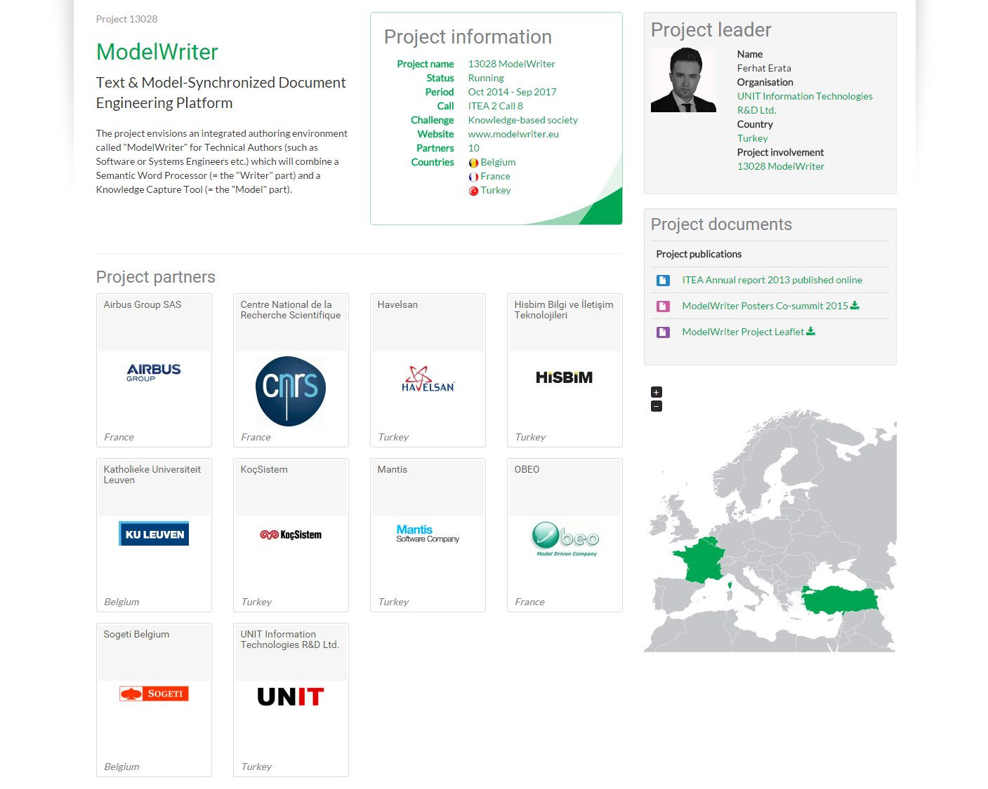
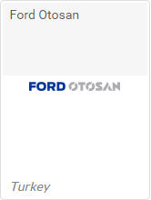
Industrial End User (self-funded partner).
Application Lifecycle Management (ALM)
Industrial End User.
Testing & Global Engineering Services
Industrial End User (self-funded partner).
Product Lifecycle Management (PLM)
Notes:
Space Application left the project at the very begining. But the situtation is covered immediatly. I took the leadership. Airbus took the leadership of
Havelsan joined the consortium to provide an industrial use case and introduce a new domain for ModelWriter project, Application Lifecycle Management (ALM). Besides that, they will collaborate with us in the context of existing one use case.
Ford Otosan is the second largest company in Turkey. They will collaborate with us in the context of one existing use case.
I would like to indicate that Havelsan and Ford Otosan are self funded partners, that joined our consortium later.
Since new partners joined in our consortium and waiting for Belgian Consortium on board again, we have postponed to sign PCA until the end of 2014.

Slide 8

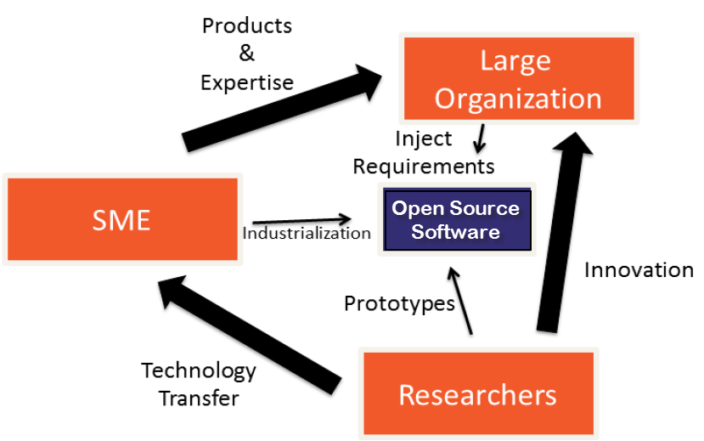





Industrialization Triangle in ModelWriter Open Source Software
Industrial Use Cases
Success Stories
Long Term Agreements
ModelWriter
Tool Providers:
Commercialization
- New Product & Services
Standardization
- Open Source Software
Technology Providers:
New Standard or Standard Extension
Publications, Open Source Software
Notes:
Open-Source Software Platform to be submitted to Eclipse Foundation
“MW” Knowledge Dissemination Standard (.mw ModelWriter exchange format)
We transfer the knowledge in university to industry which they develope the theory and prototypes.
by means of combining the expertise of SMEs of the consortium (in our case, eclipse)
In this triangle, Large Organizations (most of their dominant core business are not software related services) provides the industrial expertise and define requirements
SMEs commercialize the solutions in the market as products and services such as a commercial extension in Microsoft Office Word.
But the main aim is to keep the Open Source project alive by the Eclipse Community.
We believe it is important for the sake of the continuity of the project.

Slide 9
ModelWriter Project Overview
Resource Allocation: 68,71 person year
Project Duration: 36 months
Planned Budget: 5,543,000 Euro
Start and Finish Date: 01 Oct 2014 – 30 Sep 2017
Open-Source Software Platform to be submitted to Eclipse Foundation
Notes:
The estimated total cost of the project is more than 5 milion euros.
We are very close to the first release of ModelWriter

Slide 10
ModelWriter Today’s Knowledge Capture
Knowledge Capture with Word Processors
Document-centric,
Knowledge Capture with Modelling Tools
Model-centric, Structural and formal
Seamless Knowledge Capture with ModelWriter
ModelWriter as integrated product
Technical Documents
Natural Language
multiple information modelling and exploitation tools (= “Model” part),
and keeps both views seamlessly synchronized with each other.
Requirements, Specifications Architectural Design Documents..
Very Informal ones (mind maps, text tables, spreadsheets)
Formal ones (UML, SysML, EMF, BPMN …)
Text-based
a Word Processor (= “Writer” part)
Notes:
Let me introduce your three pillar, motivation, three main functionality of the project.
One them is knowledge Capture, The other one is Knowledge Extraction, The third one is Consistency checking.

Slide 11
ModelWriter bi-directional Knowledge Capture tool

Slide 12
ModelWriter Text-Based Knowledge Extraction
Understands the various textual parts of a document expressed in Natural Language
Reveals concepts and relationships between them (“Model”-part)
Semantic Word Processor
(Text-Based Knowledge Extractor)
Consistency & Completeness Checking

Slide 13
ModelWriter Further Knowledge Valorizations
“Everywhere” Document Regeneration: "tell once, show everywhere“: recycling knowledge from (1) the same document, or of (2) another related document
Open Source Software under Eclipse Foundation for Future Dissemination and Exploitation to further extend the Business Value Chain
Consistency Checking: the objective to provide a Consistency Checker that automates Quality Reviews of Requirements Engineering
“MW” Knowledge Dissemination Standard (.mw ModelWriter exchange format)
Notes:
OPEN API: plug-ins (e.g. for a future Natural Language Question Answering System plug-in, domain-specific checkers or generators, etc.)

Slide 14
Level of Collaboration within ModelWriter Exploitation of MW in Eclipse & ASSUME
Yvan Lussard
Ferhat Erata
Open Source Software (Eclipse Public License)
Eclipse Mylyn Intent Project Lead
ITEA2 ModelWriter Project Lead
Text & Model Synchronized Document Enginerring
Dr. Moharram Challenger
Requirement Formalization
Product Lifecycle Traceability
Jean Souyris
ITEA3-ASSUME Project
Oğuzhan Şereflişan
Prof. Geylani Kardaş
Dr. Emrah Kınav
Notes:
Although deep collaboration in France and Turkey between partners, indeed we have also international collaborations,
New system (Exploitation): Exploitation of ModelWriter in ITEA3-ASSUME

Slide 15
Level of Collaboration within ModelWriter International Collaboration (through UCs)
Emil Khamitov
Dr. Anne Monceaux
AIRBUS SIDP Documentation
Prof. Geylani Kardaş
Ferhat Erata
Dr. Eray Tüzün
Yagub Macit
Dr. Moharram Challenger
HAVELSAN Req. Specification
Yiğitcan Şener
Mehmet Önat
Prof. Claire Gardent
Hale Gezgen
Prof. Samuel Cruz-Lara
Dr. Mariem Mahfoudh

Slide 16
Level of Collaboration within ModelWriter International Collaboration (through plugins)
Taşkın Kızıl
Ersan Gürdoğan
Commercial Product
Oğuz Yıldız
Yvan Lussard
Ferhat Erata
Microsoft Word Plug-in for ModelWriter
Dr. Moharram Challenger
Prof. Geylani Kardaş
Yiğitcan Şener
Mehmet Önat
Hale Gezgen
Notes:
Although deep collaboration in France and Turkey between partners, indeed we have also international collaborations,
New system (Exploitation): Exploitation of ModelWriter in ITEA3-ASSUME

Slide 17

Level of Collaboration within ModelWriter International Collaboration (research)
Prof. Hans Vangheluwe
Prof. Geylani Kardaş
Dr. Eray Tüzün
Research Collaboration
McGill University & University of Antwerp
Modeling, Design & Simulation Lab.
Multi-Paradigm Modeling, Formalism Transformation,
Multi Agent Software Lab.
Ege University
Domain Specific Modeling Languages
Application Lifecycle Management, Model Driven Engineering

Slide 18
Technological components & interactions Colloboration by WP interactions
Notes:
These are the building Blocks of ModelWriter. As you can see, there exists strong dependency between components which results collaboration not only inside a work package but also other WPs.

Slide 19

ModelWriter Conceptual Architecture
Editor
Documents
(doc, docx, odt,textile,etc)
Text
Connectors
Text
Semantic
Module
KB
Model
Models Connectors
Model Integration
Module
Model
Models
Notes:
Simplified version of actual architecture, there is a striking resemblance between planned and actual ones which means logical decomposition of project based on fucntions corresponds the real architecture.

Slide 20
ModelWriter Work Packages & Technical Innovations
WP1 Industrial Use Cases and Requirements (AIRBUS)
WP3 (UNIT)
WP4 (MANTIS)
WP6 (OBEO)
WP2 (LORIA)
Semantic Parser
Bi-directional synchronization mechanism between texts and models
A federated Knowledge Base and its API
A complete “ModelWriter” tool integrating of all these in a consistent way
Synchronization mechanism between texts/models & knowledge base
bi-directional transformation between text and formal knowledge representation
User Interfaces
Consistency checker plug-in for consistency
Configuration & Traceability Components
Document Generation
WP5 Project Management (UNIT)
WP7 Standardization, Dissemination and Exploitation (OBEO)
Notes:
Those are the technical workpackages from which we expect innovations. Here is listed the most important software components/functionalities.

Slide 21
ModelWriter Overall Progress in the first year
WP5: Management Infrastructure
(D5.1.1)
[M1]
WP1: Consolidated User Requirements
(D1.5.1 & D1.5.2)
[M6]
WP:1 Software Requirements
(D1.6.1 & D1.6.2)
[M7]
WP6: Architecture Design
(D6.1.2)
[M9]
WP3: Synchronization, Configuration, Traceability
(D3.4.1, D3.5.1, D3.6.1)
[M10]
WP6: Major first release
(D6.7.1)
[M16]
WP6: Several Prototypes
(D6.1.1)
[M8]
WP2: Semantic Parser
(D2.1.1, D2.1.2, D2.3.1)
[M11]
WP6: User Interfaces & Model & Text Connectors
(D6.3.1, D6.4.2)
[M12]

Slide 22
ModelWriter Workshops in the 1st Year https://github.com/modelwriter/workshops
Organized by KoçSistem
The 1st International ModelWriter Workshop in Izmir, Turkey (Jan 15-17, 2015) [M4]
The 2nd International ModelWriter Workshop in Brussels, Belgium (Apr 30, 2015) [M7]
The 3rd International ModelWriter Workshop in Toulouse, France (Jun 22-23, 2015) [M10]
The 4th International ModelWriter Workshop in Brussels, Belgium (Sep 23-24, 2015) [M12]
The 1st International Eureka Project Exhibition in Berlin, Germany (Mar 10-11, 2015) [M6]
Project Kick-off in Istanbul, Turkey (Nov 08, 2014) [M1]
Initial Architectural Design, Indutrial Use Cases, Technical WP discussions
Collaboration Infrastructure
Organized by UNIT
Exploitation: Havelsan’s participation
Consolidated User Requirements & Review
Organized by Eureka-ITEA Office
Organized by Sogeti
Software Requirements Review & Architecture
Organized by Eclipse Foundation
Exploitation: FordOtosan’s participation
Organized by Eureka-ITEA Office
Notes:
In addition to montly and bi-weekly meetings, we have organized workshops for every 2 or 3 months in diffrent cities across Europe. In each one, we get concrete results.
We organized 2 workshops in Turkey, Istanbul and Izmir.
We consolidated User Requirements in Brussels. The workshop was hosted by Sogeti.
In Toulouse, we specified software requirements and finalized the architecture and start to focus on development of integrated parts.
In Germany, we will have two days development camp during the Eclipse Europe Conference.

Slide 23
ModelWriter Workshops in the 2nd Year https://github.com/modelwriter/workshops
Exploitation in ITEA-3 project
The 5th International ModelWriter Workshop in Ludwigsburg, Germany (Nov 2-5, 2015) [M14]
The 6th International ModelWriter Workshop in Paris, France (Feb 15-16, 2016) [M17]
ITEA3 Assume-Project Kick-off in Berlin, Germany (Oct 1-2 2015) [M13]
Organized Daimler & Bosch
Hosted by Eclipse Foundation
Integration of Components
Product Owner Review Meeting
Organized by Airbus SAS
Notes:
In addition to montly and bi-weekly meetings, we have organized workshops for every 2 or 3 months in diffrent cities across Europe. In each one, we get concrete results.
We organized 2 workshops in Turkey, Istanbul and Izmir.
We consolidated User Requirements in Brussels. The workshop was hosted by Sogeti.
In Toulouse, we specified software requirements and finalized the architecture and start to focus on development of integrated parts.
In Germany, we will have two days development camp during the Eclipse Europe Conference.

Slide 24
Open Source Campaign Open Call for Industrial User Stories
Shape the future ModelWriter
Early adaptation of the technology
Long Term Support

Slide 25
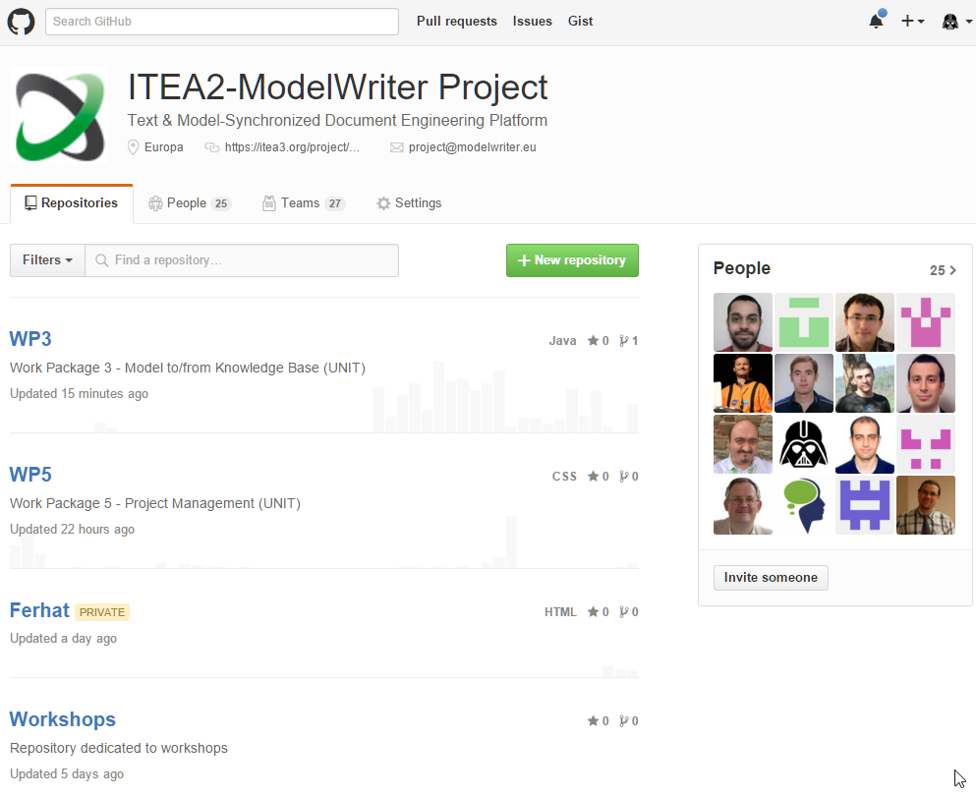
ModelWriter Open Source Campaign https://github.com/modelwriter
Notes:
GitHub donate us a lifetime license for our project

Slide 26
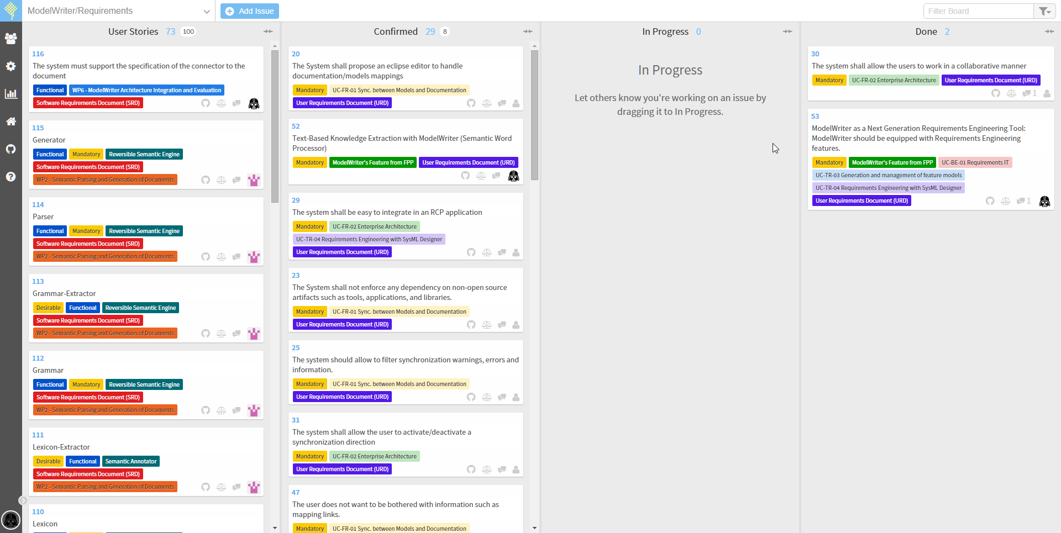
ModelWriter Requirements & User Stories https://waffle.io/modelwriter/requirements

Slide 27
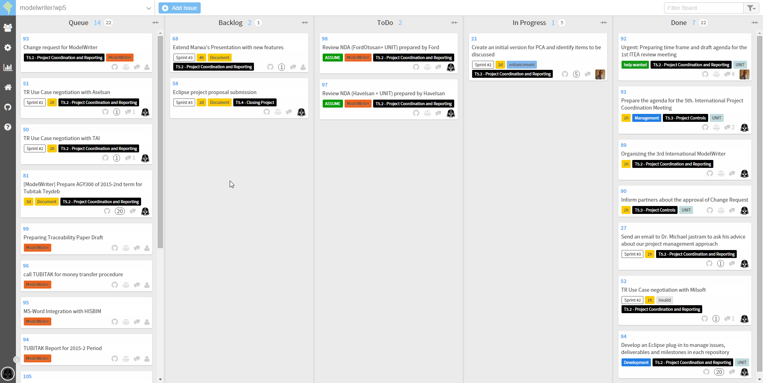
ModelWriter Requirements & User Stories https://waffle.io/modelwriter/wp5

Slide 28
What is the problem?

Slide 29
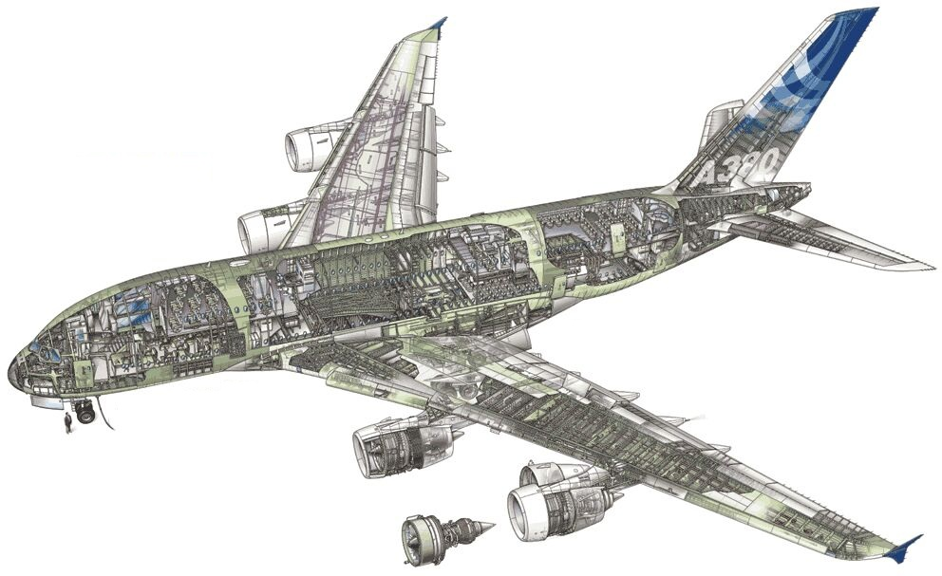
Airbus A380!
Imagine the documentation related to design principles.

Slide 30

Plants!
Imagine the documentation of a construction site.

Slide 31
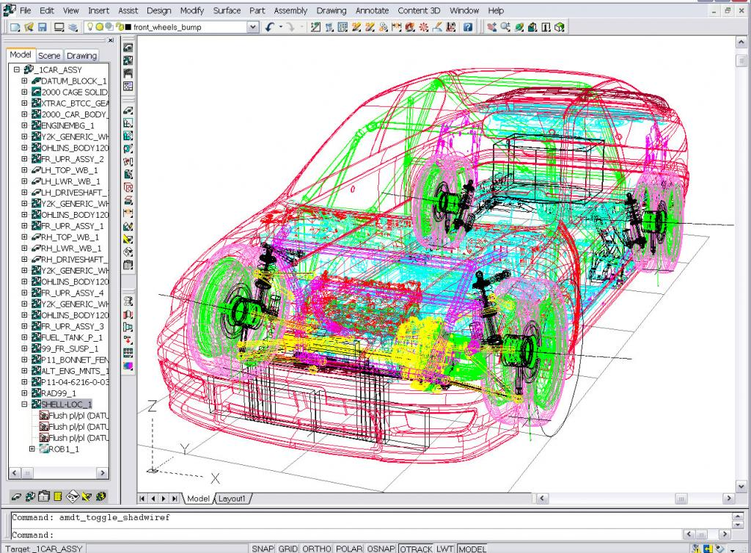
Automobiles!
Imagine the technical specifications

Slide 32
Documentation!
Write once … and never look at after

Slide 33
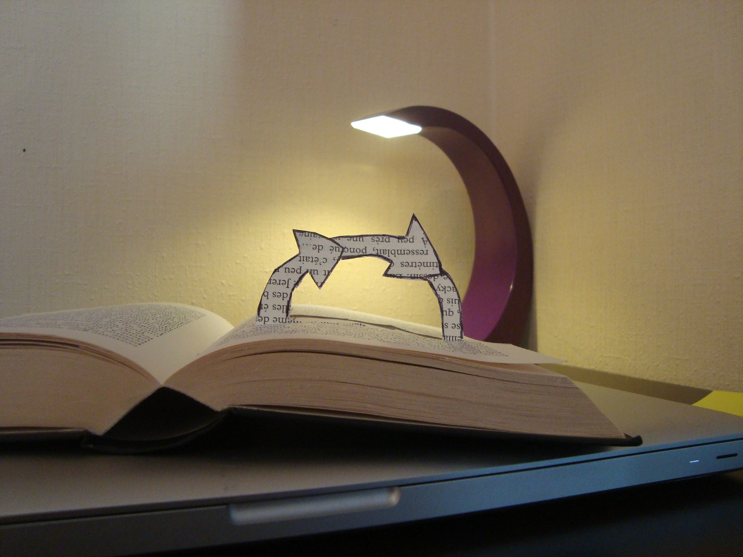
Documentation!
Hard to keep it up-to-date

Slide 34

Documentation!
Useful for users / Boring to write

Slide 35

Semantics!
No meaning of syntax (words, sentences …)

Slide 36
What is a text?

Slide 37
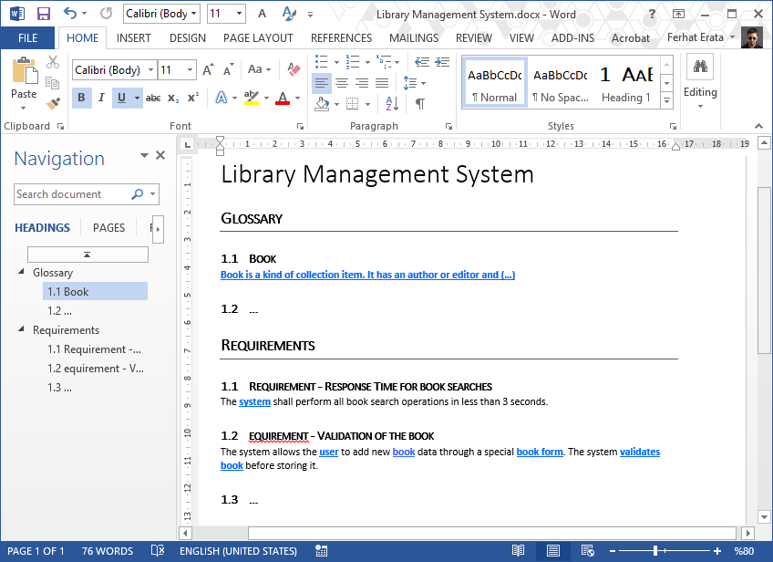
What is a text? (document file formats) Office Open XML (.docx) (ISO/IEC 29500)

Slide 38
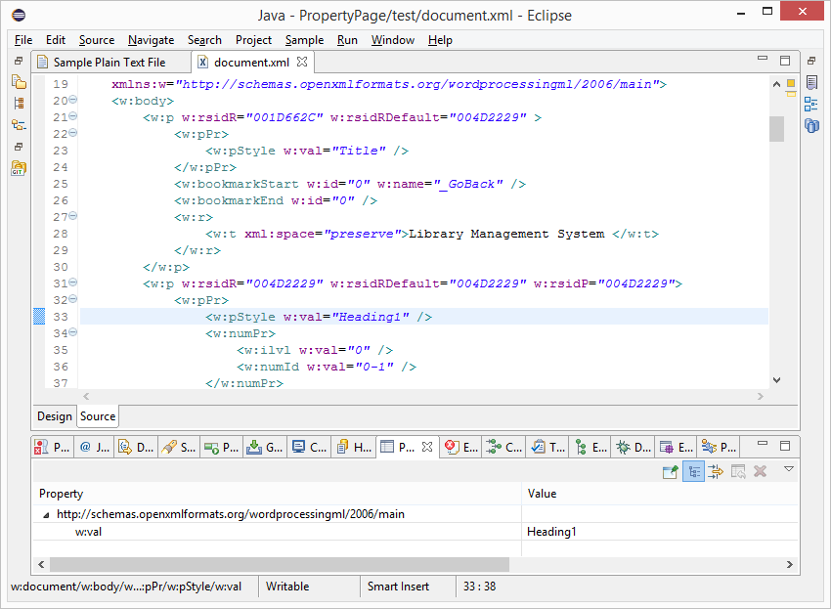
What is a text? (document file formats) Office Open XML (.docx) (ISO/IEC 29500)

Slide 39
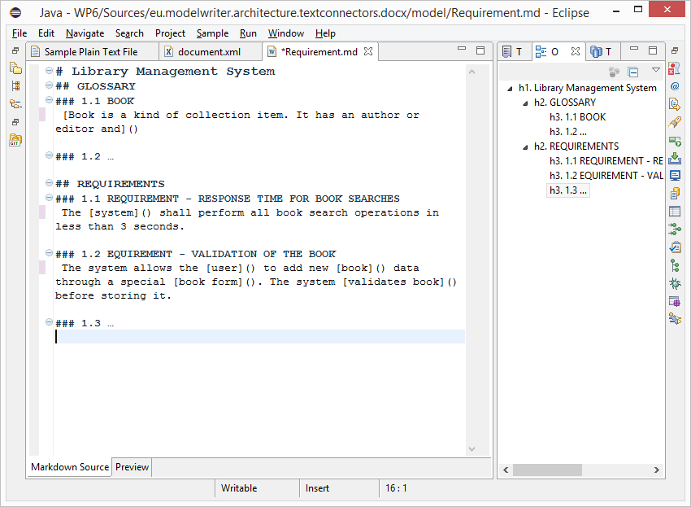
What is a text? (.md source file) text/markdown (ICANN Standard)

Slide 40
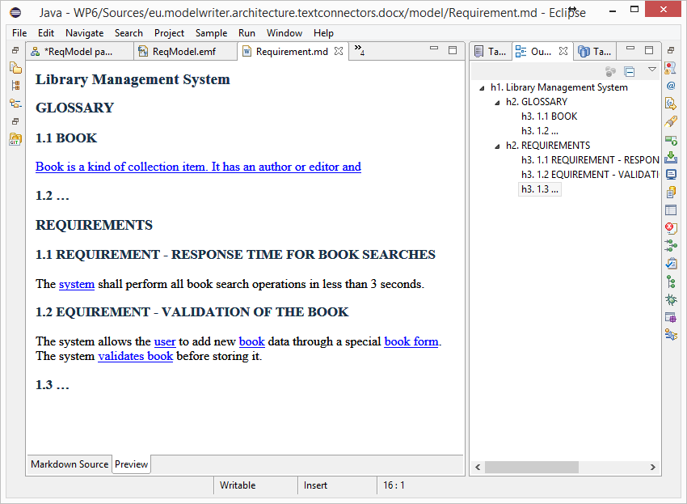
What is a text? (HTML Preview) text/markdown (ICANN Standard)

Slide 41
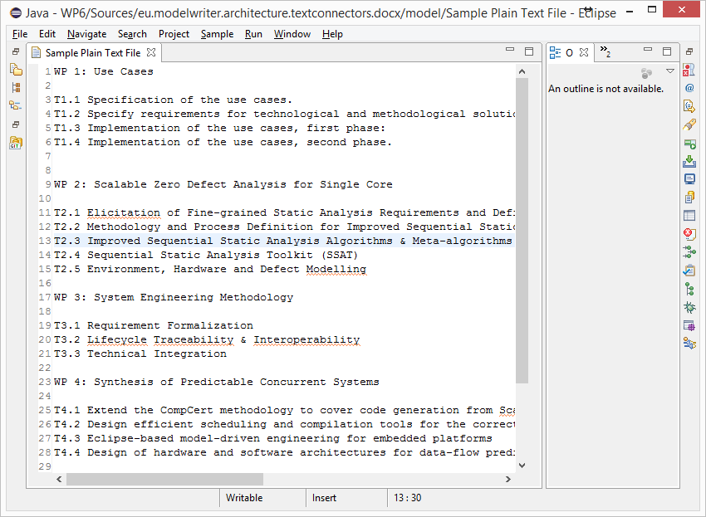
What is a text? (unformatted text) text/plain (ICANN Standard)

Slide 42
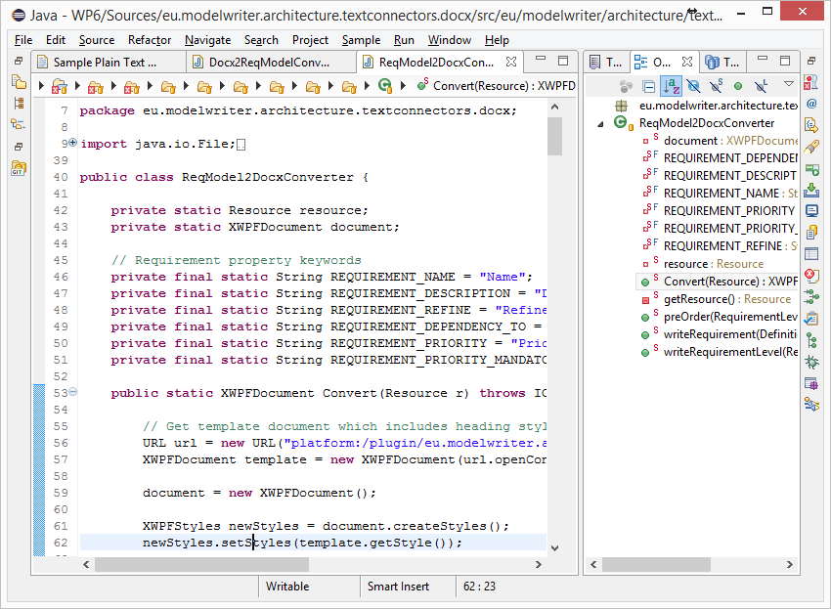
What is a text? (code files) Java, C++ … Programing Languages

Slide 43
What is a model?

Slide 44
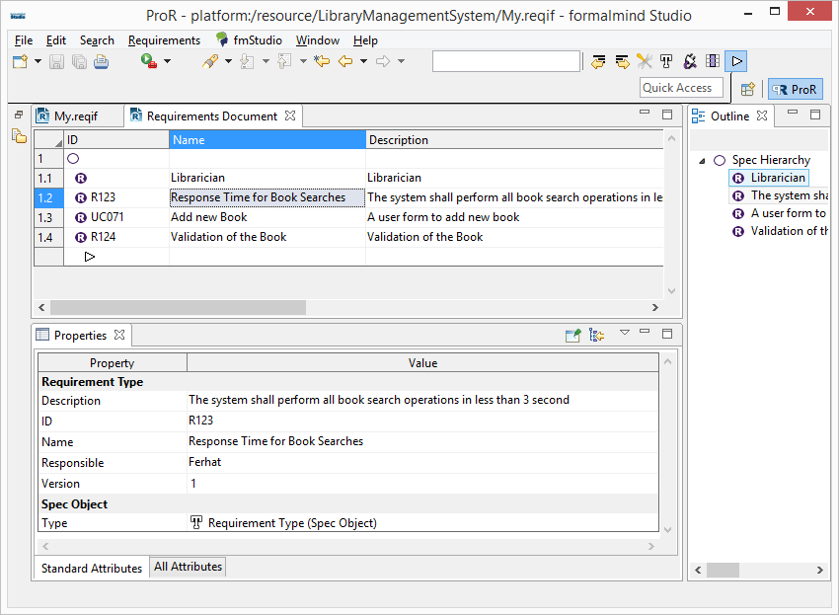
Everything is a model! (ReqIF Standard) Requirements Interchange Format

Slide 45
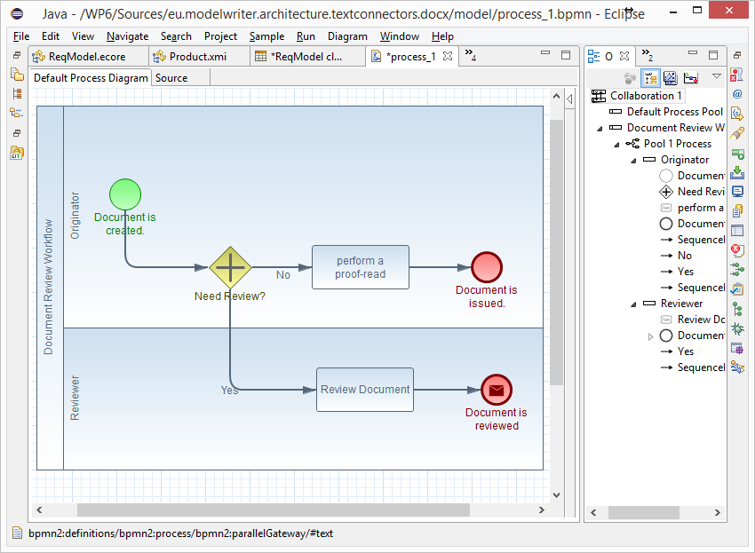
Everything is a model! (BPMN Standard) Business Process Model & Notation

Slide 46
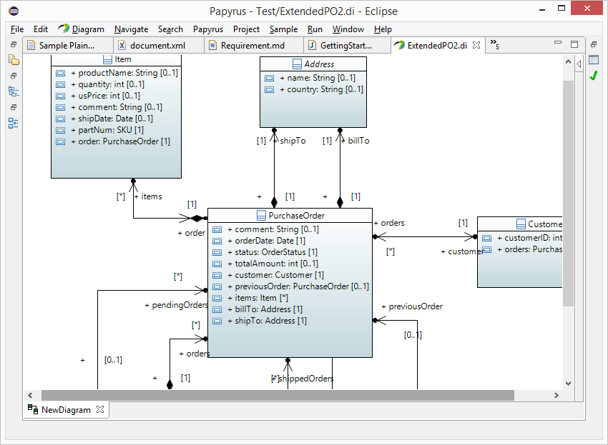
Everything is a model! (UML Standard) UML Modeling Languages

Slide 47
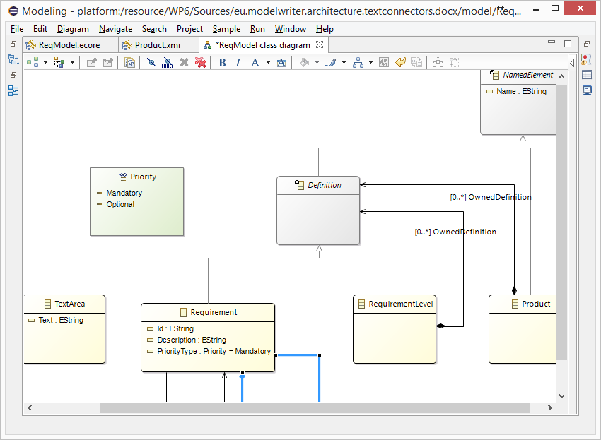
Everything is a model! Eclipse Modeling Framework (EMF)

Slide 48
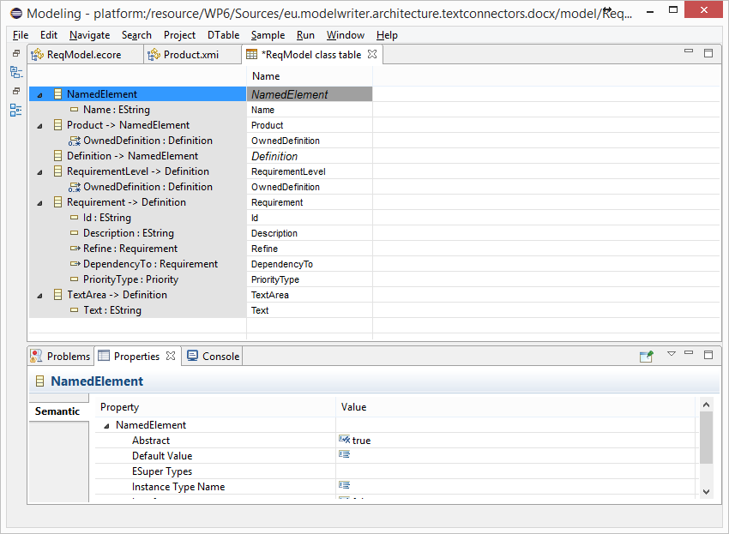
Everything is a model! Tree-based or Tabular Representations

Slide 49
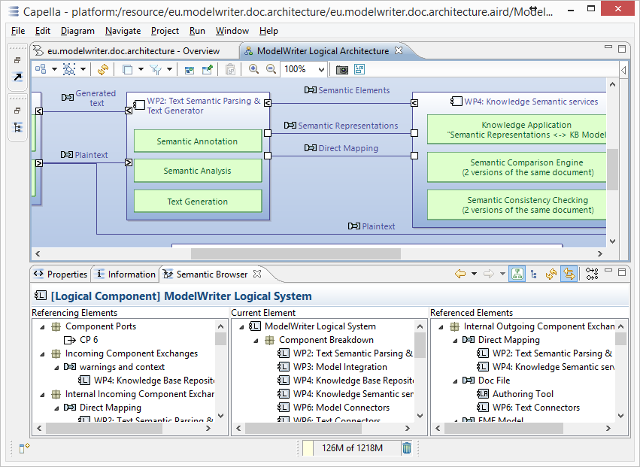
Everything is a model! Software/System Architecture Design

Slide 50
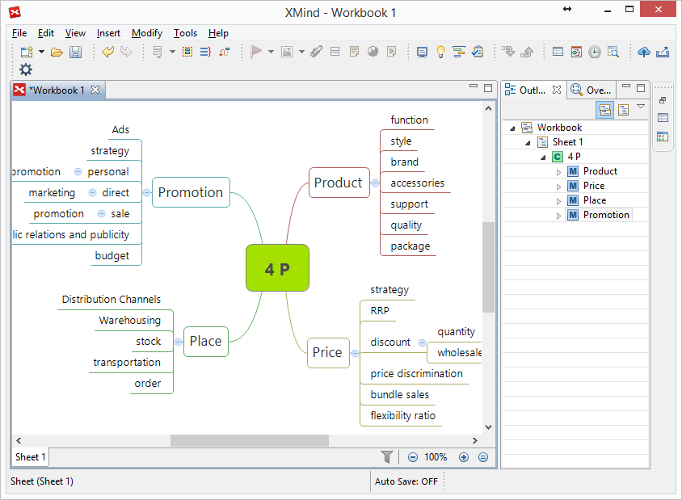
Everything is a model! Topic Maps, Mind Maps, Vocabularies …

Slide 51
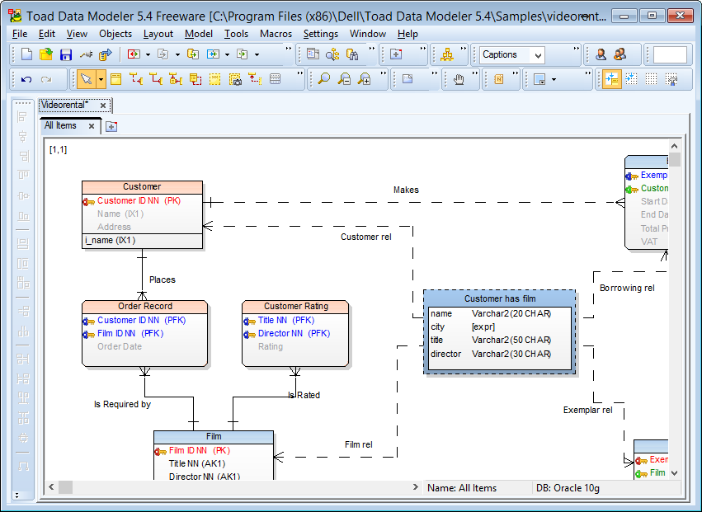
Everything is a model! Databases (ER, IDEF1.x)

Slide 52
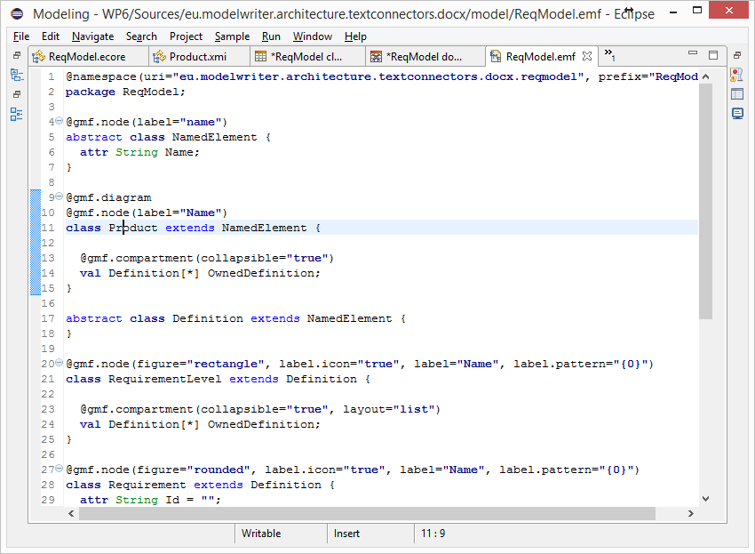
Everything is a model! (Textual Lang.) Domain Specific Languages

Slide 53
Everything is a model! (Java, C++, etc.) Even Programing Languages (ASTs)

Slide 54
Is it possible to connect and keep arbitrary software/system engineering artifacts synchronized ?

Slide 55
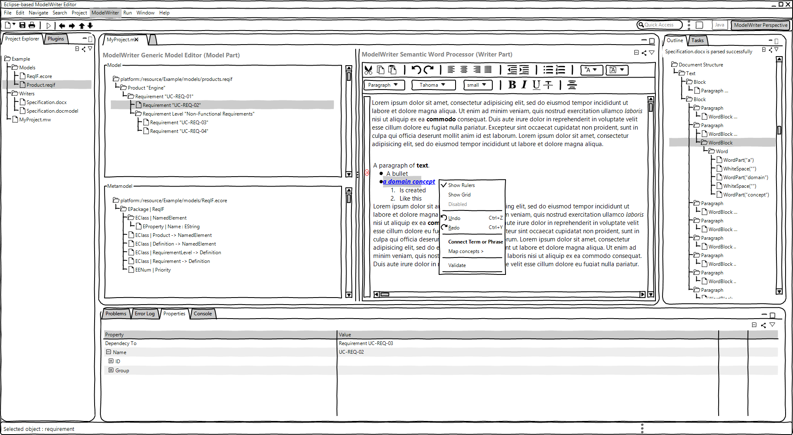
ModelWriter – The Solution
Text & Model-Synchronized Document Engineering Platform

Slide 56
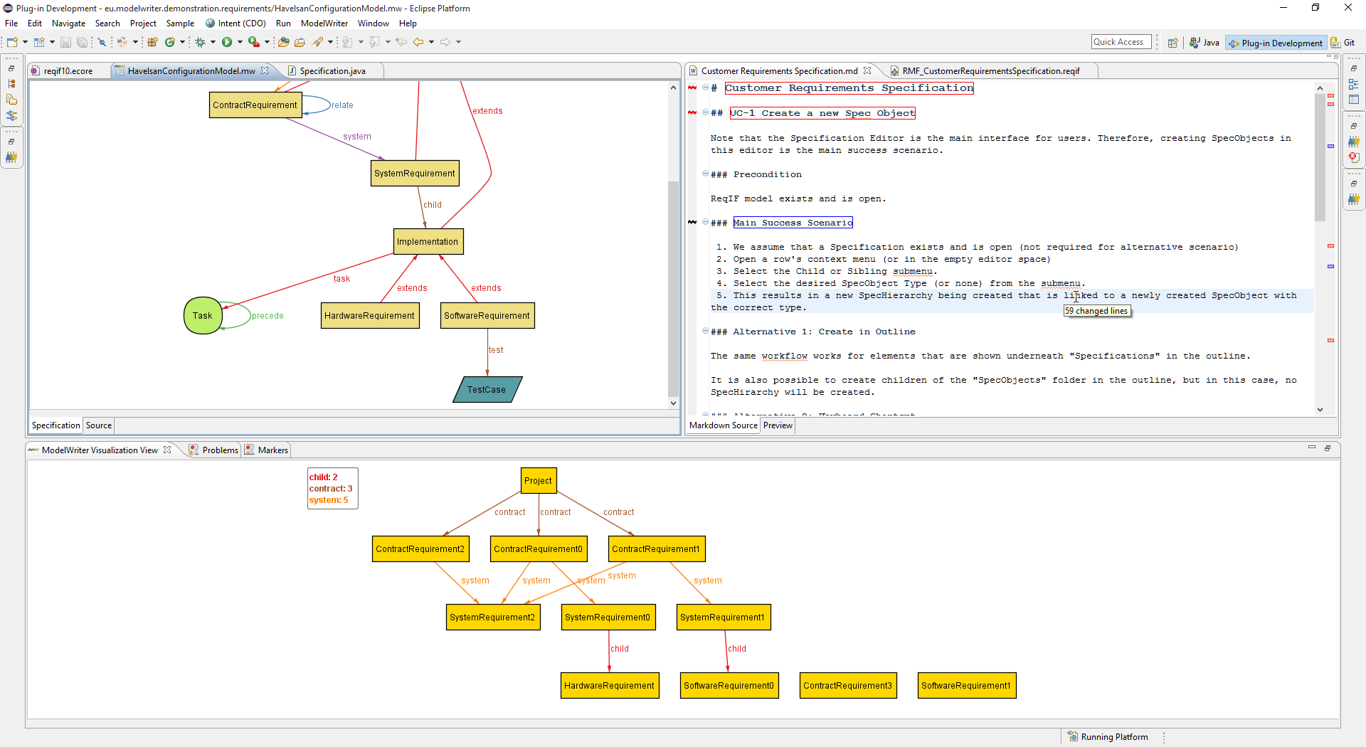
Solution – Knowledge Capture
Text & Model-Synchronized Document Engineering Platform

Slide 57
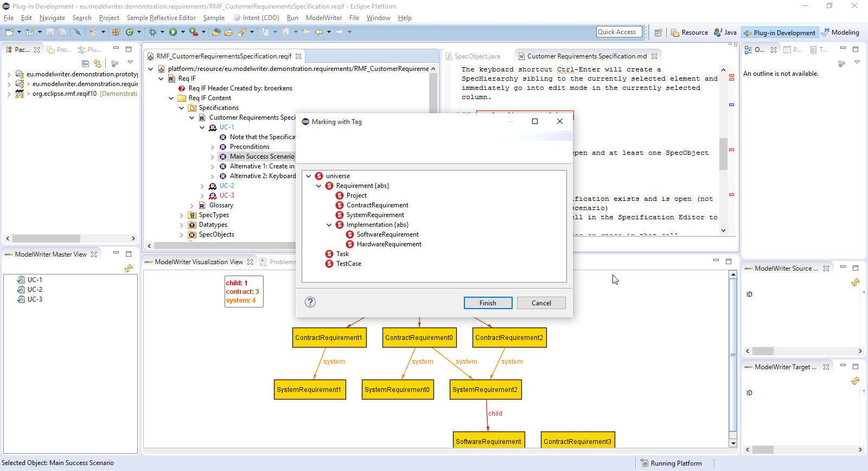
Solution – Knowledge Capture
Text & Model-Synchronized Document Engineering Platform

Slide 58
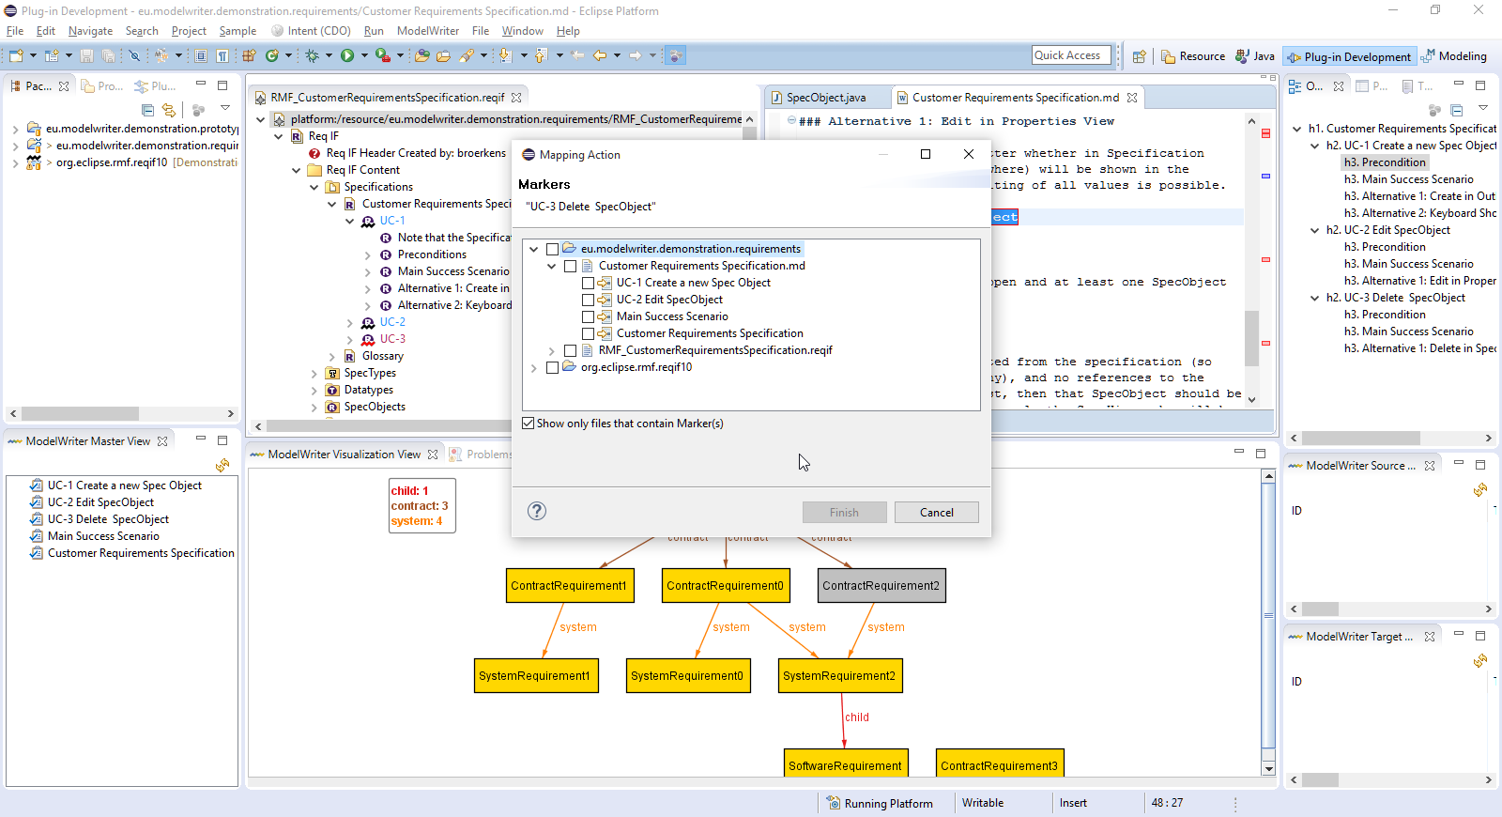
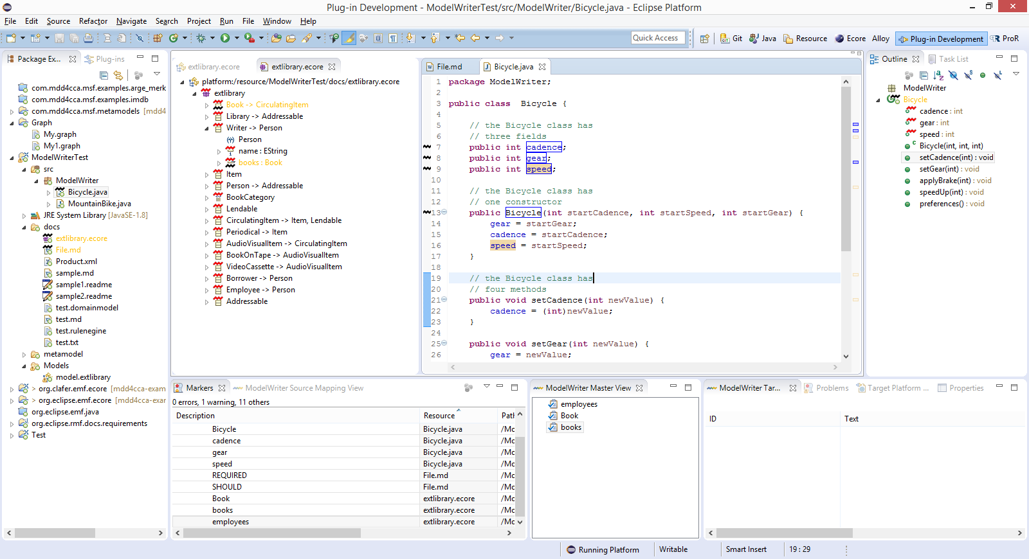
Solution – Knowledge Capture
Text & Model-Synchronized Document Engineering Platform

Slide 59
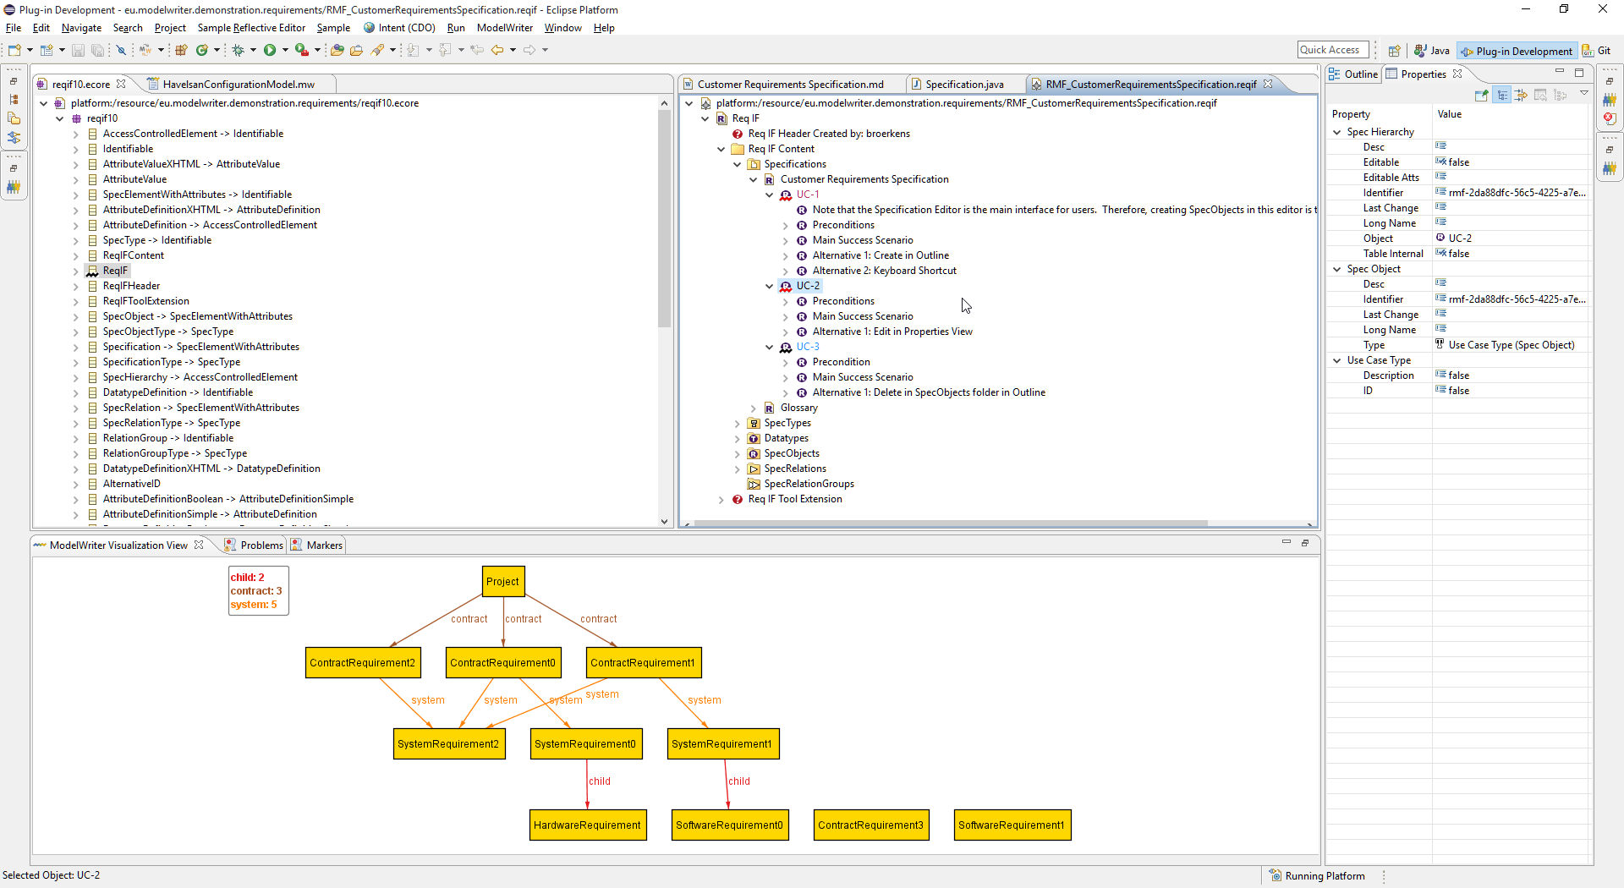
Model and its Instances
Text & Model-Synchronized Document Engineering Platform

Slide 60
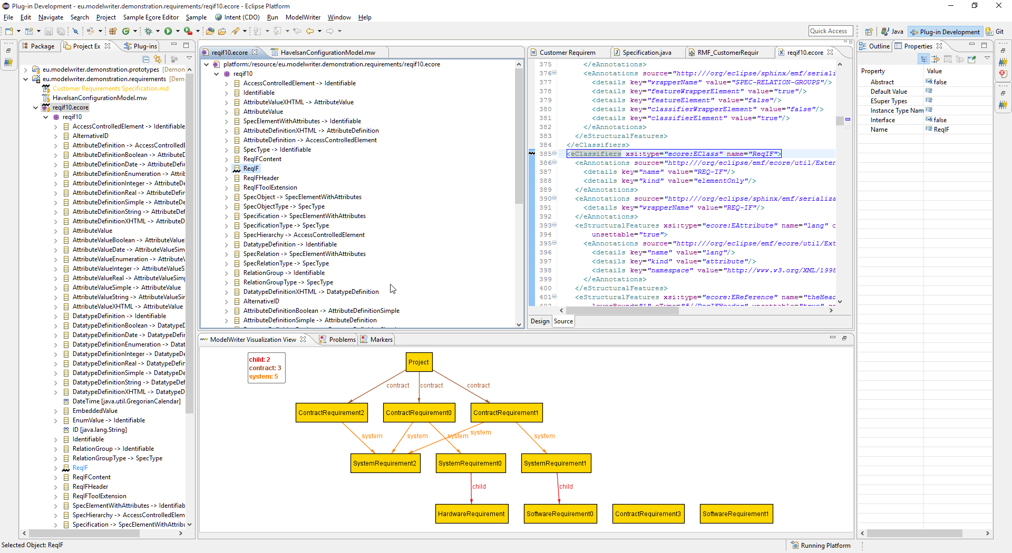
OMG ReqIF ECore Metamodel
Text & Model-Synchronized Document Engineering Platform

Slide 61
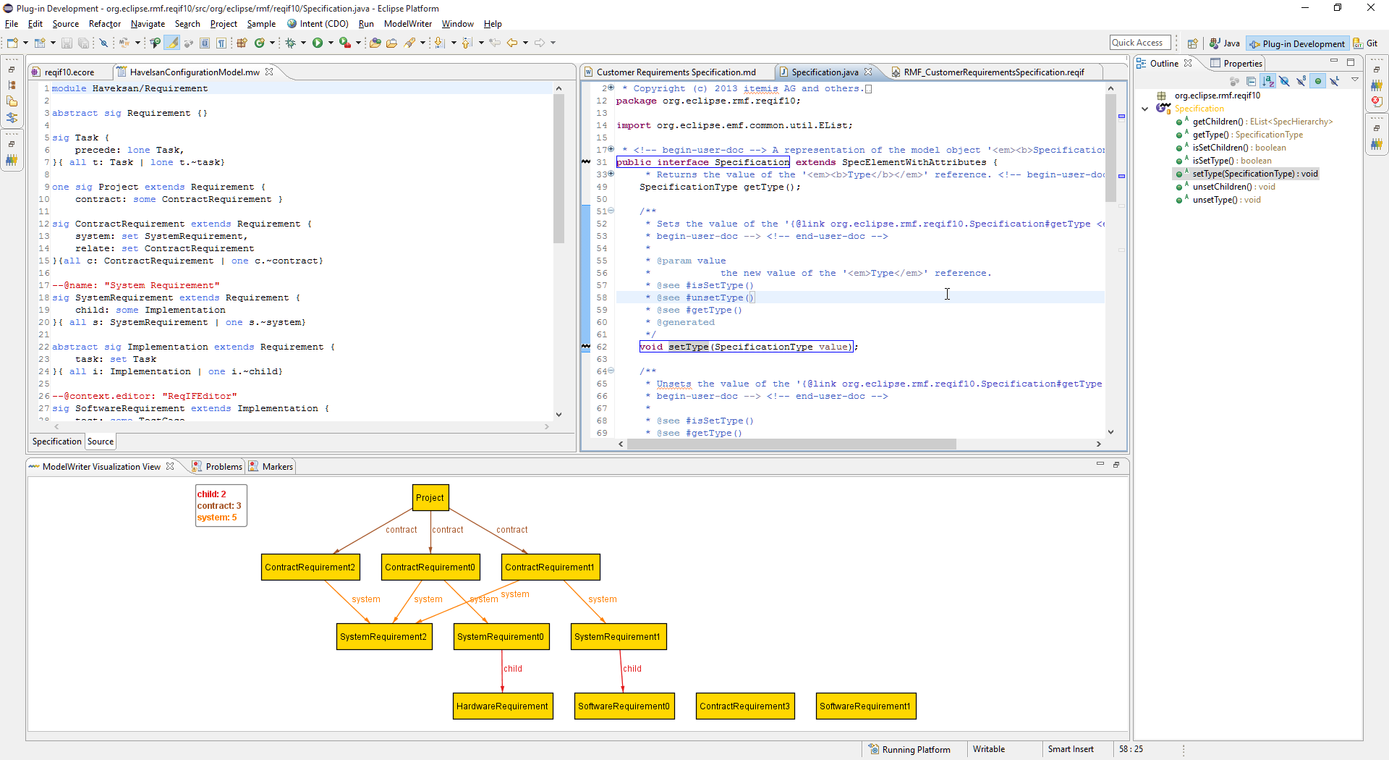
Java Classes and Interfaces
Text & Model-Synchronized Document Engineering Platform

Slide 62
Arbitrary Text Files (markdown...)
Text & Model-Synchronized Document Engineering Platform

Slide 63
Is it possible to extract knowledge from texts fragments based on a given ontology (model) ?

Slide 64
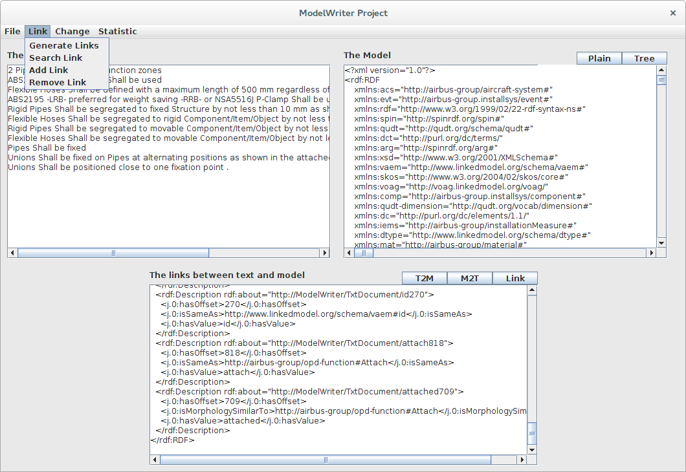
Solution – Knowledge Extraction
Text & Model-Synchronized Document Engineering Platform

Slide 65
Synchronization is maintained!

Slide 66
What about configuration/formalization of the platform?

Slide 67
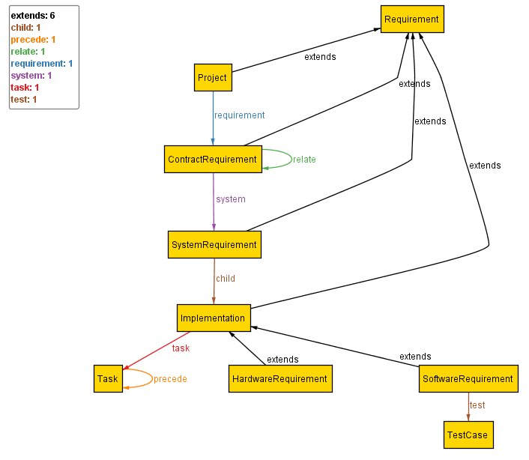
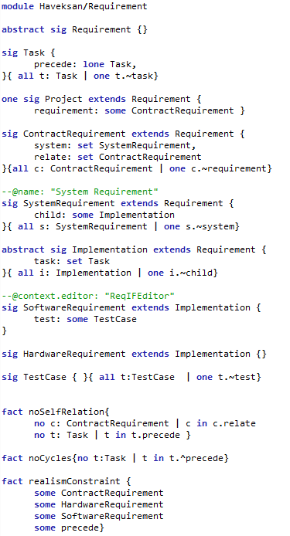
Configuration: Havelsan example
A Formal Specification Model to configure the ModelWriter

Slide 68
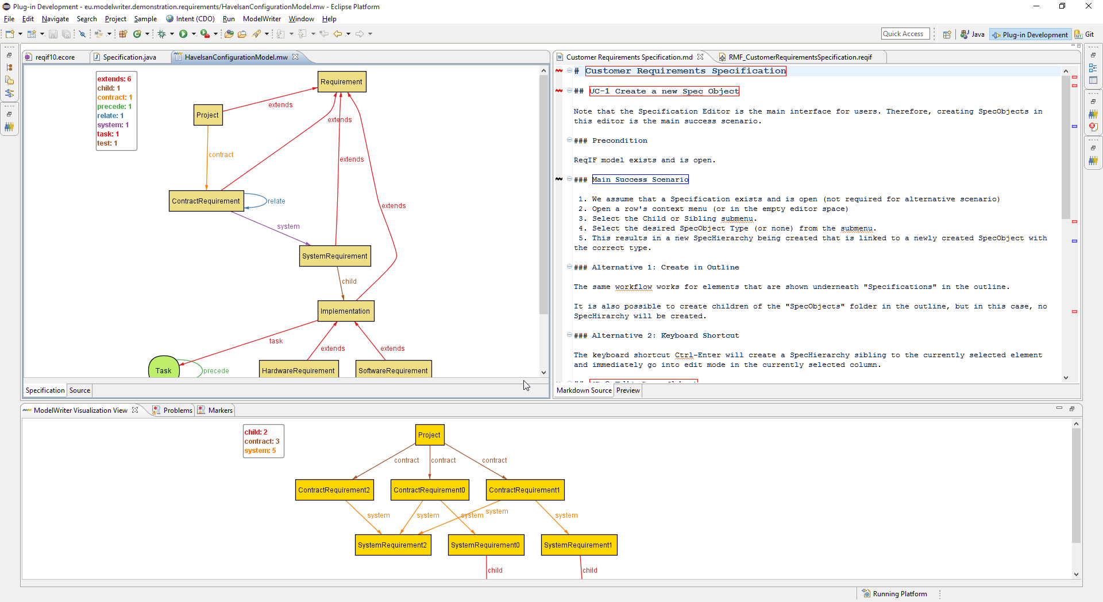
Specification: model view
A Formal Specification Model to configure the ModelWriter

Slide 69
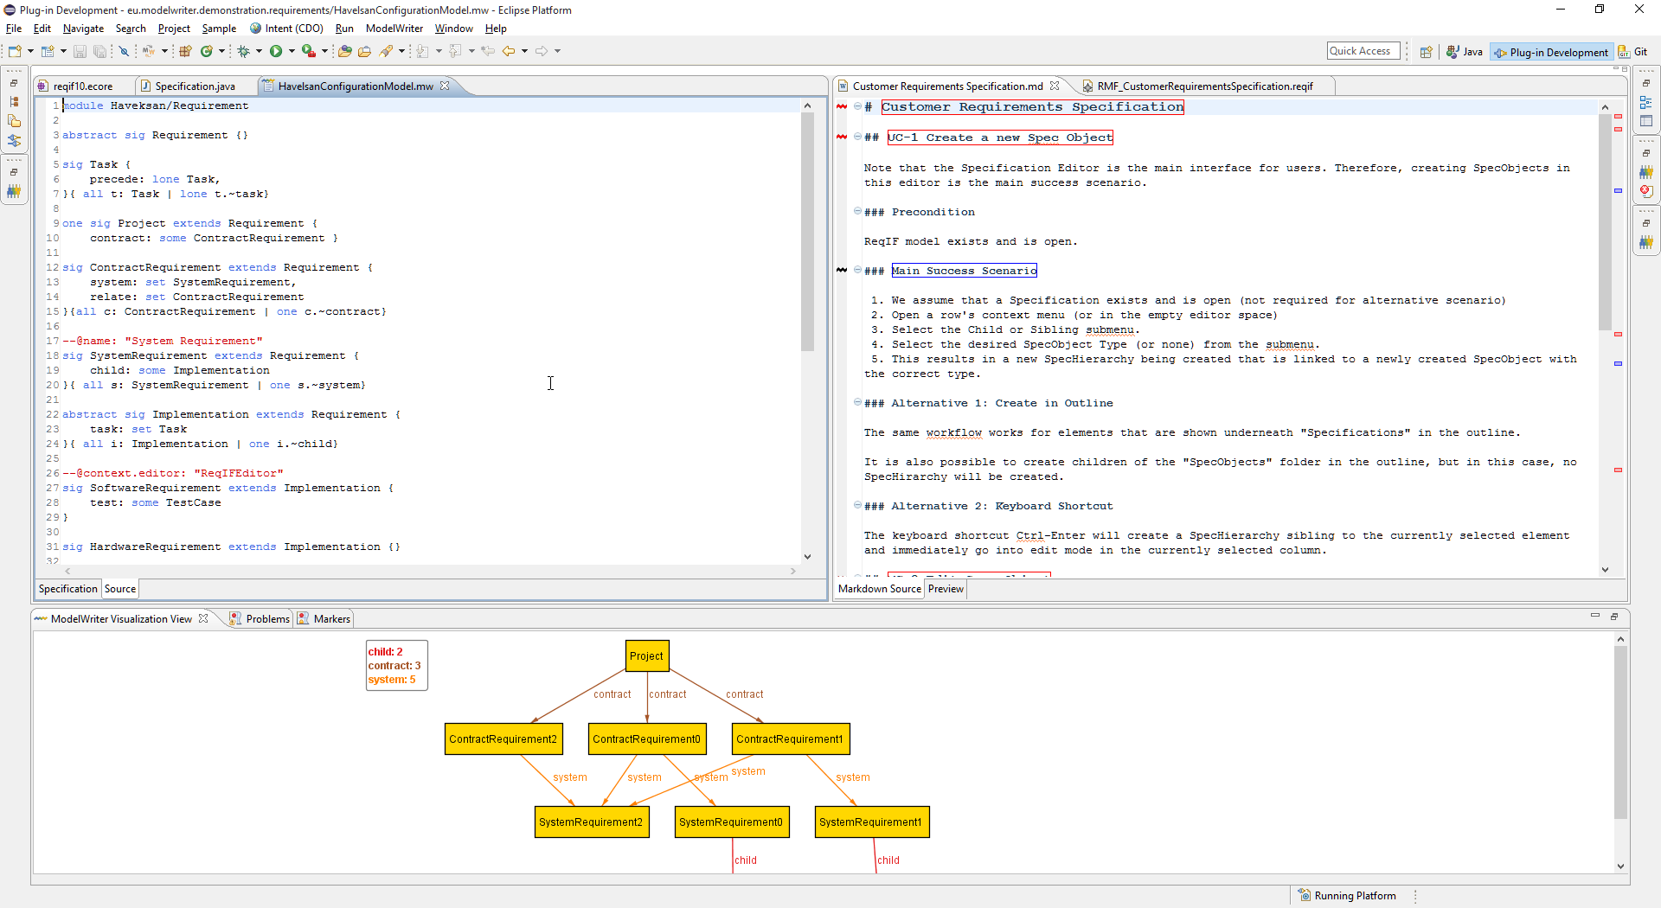
Specification: source view
A Formal Specification Model to configure the ModelWriter

Slide 70
Is it possible to vizualize the trace links?

Slide 71
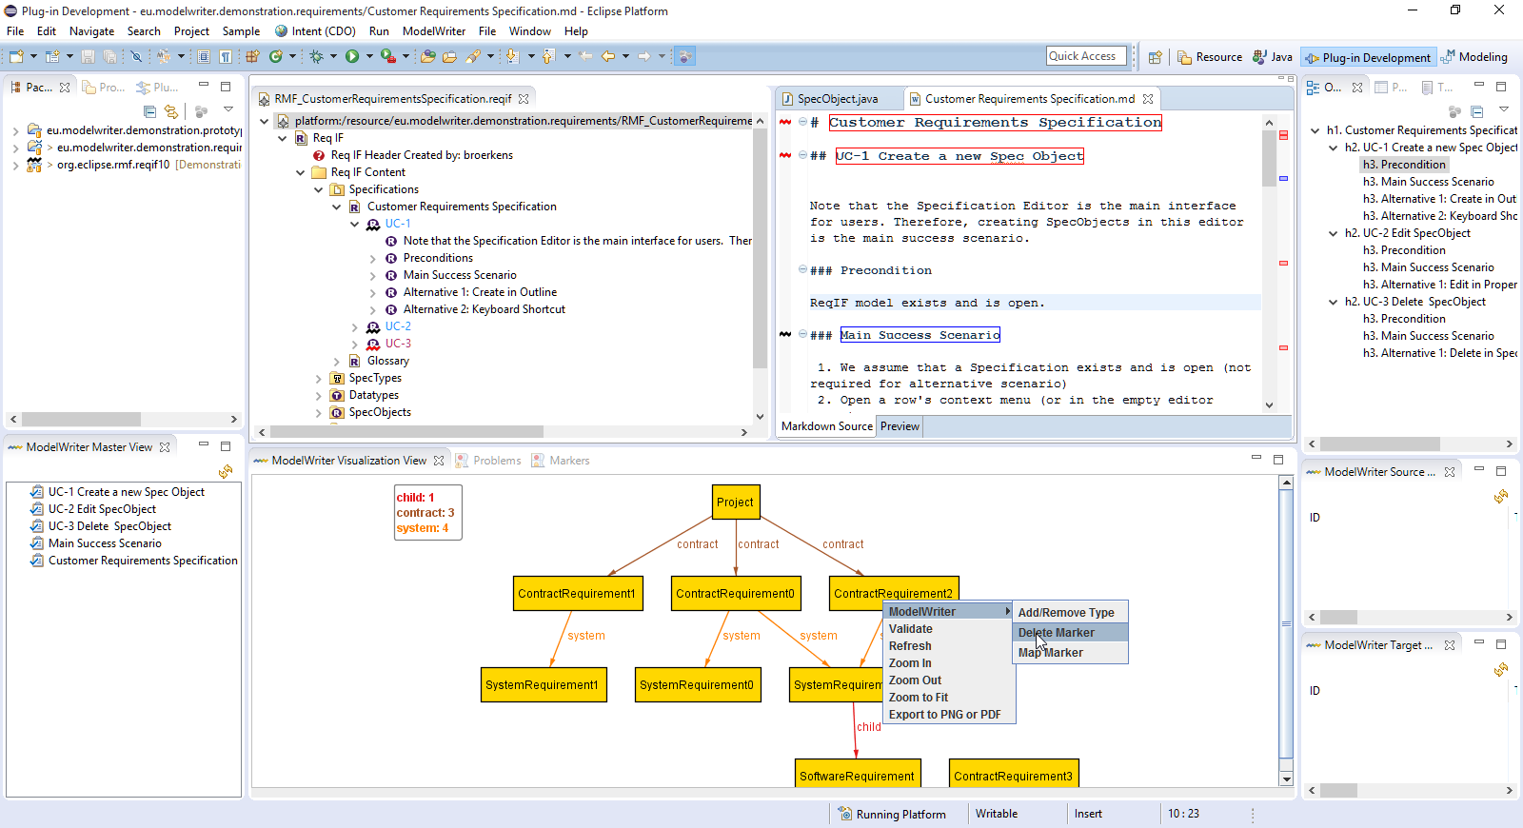
Traceability: Havelsan example
A Formal Specification Model to configure the ModelWriter

Slide 72
Synchronization is maintained!

Slide 73
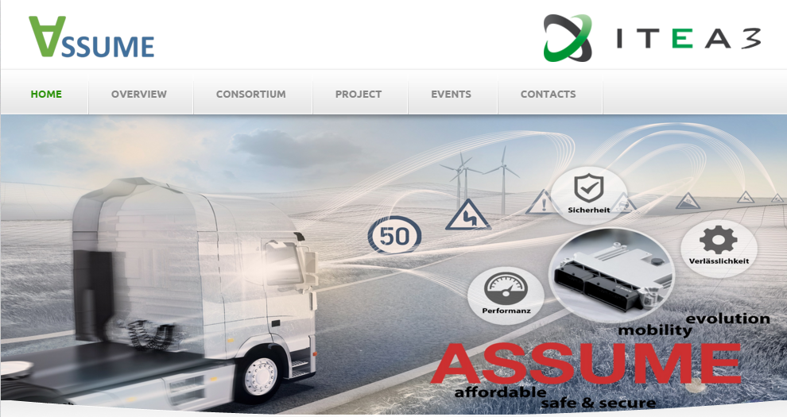
ASSUME Affordable Safe & Secure Mobility Evolution
Project Leader: Udo Gleich (udo.gleich@daimler.com)
Project Email: www.assume-project.eu

Slide 74
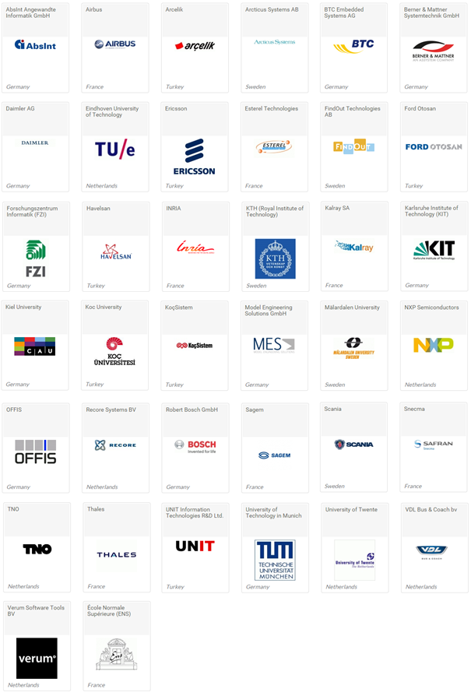
ITEA3-ASSUME Project Project Partners I

Slide 75
ITEA3-ASSUME Project Project Partners II

Slide 76
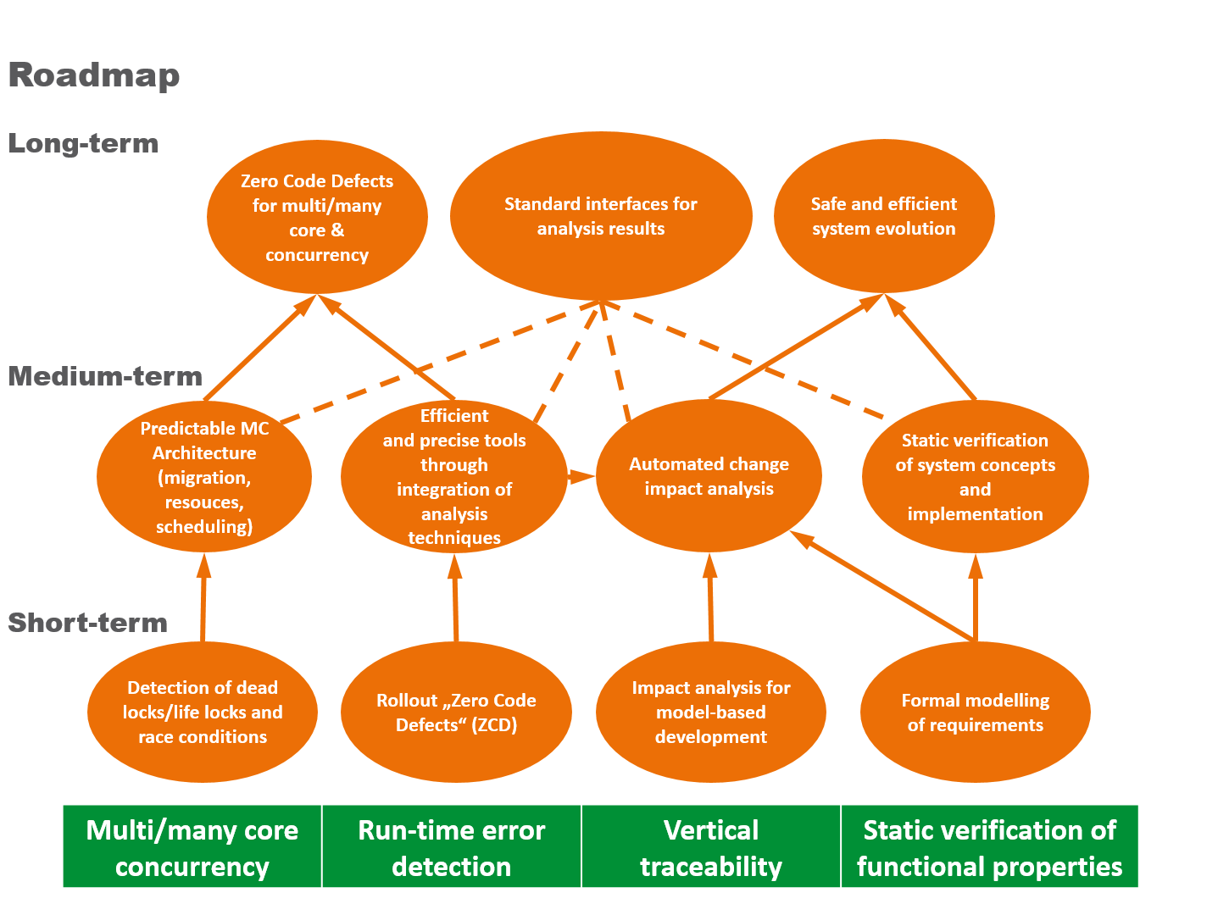
ITEA3-ASSUME Project Exploitation of ModelWriter in ASSUME
Notes:
ASSUME delivers next-generation static analysis that
scales with the complexity of future mobility systems
covers multi-core targets and industrial standards for model-driven development
proves advanced safety properties of concurrent systems

Slide 77
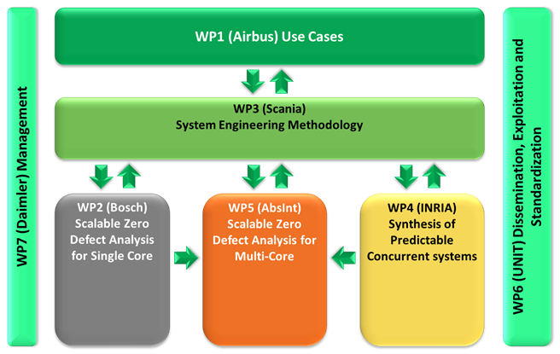
ITEA3-ASSUME Project Project Structure
Notes:
ASSUME focuses on development platform which delivers static and dynamic analysis tools for

Slide 78
Thank you for your attention We value your opinion and questions.

Slide 79
2 Progress on Workpackages
Prof. Geylani Kardaş (Moderator)
KoçSistem

Slide 80
WP1 - Industrial use case and requirements
Leader: Anne MONCEAUX
AIRBUS GROUP

Slide 81
WP1-Industrial Use Cases & Requirements
To describe and define the industrial, real life Use Cases, their associated requirements and evaluation method.
Tasks:
T1.1 Evaluation Methods & Tools
T1.2 Industrial Use Cases for Belgium Consortium
T1.3 Industrial Use Cases for French Consortium
T1.4 Industrial Use Cases for Turkish Consortium
T1.5 Consolidated User Requirements and Review
T1.6 Consolidated Software Requirements and Review
T1.7 Annual Product Review
T1.8 Technical Risk Assessment

Slide 82
T.1.1 Evaluation Methods & Tools
HISBIM, UNIT, KOCSISTEM, AIRBUS, OBEO, MANTIS
To define evaluation methods, including the identification of metrics to quantify performance with and without ModelWriter
Status
Survey of available evaluation method and tools
D1.1.1 Evaluation Methods & Tools
Next:
Specification of use Cases KPI ; common KPI and selection of evaluation method and tools

Slide 83
T.1.1 Evaluation Methods & Tools
Evaluation should show:
What actually occurred?
Whether it had an impact, expected or unexpected, and
What links exist between a program and its observed impacts?
This will result in D1.1.1 Evaluation Methods & Tools

Slide 84
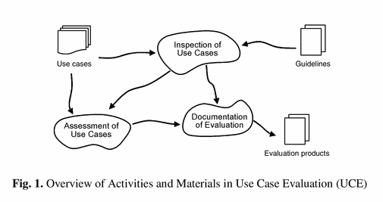
D1.1.1 Evaluation Methods & Tools
Methods & Tools should answer the questions below?
What are we trying to achieve?
Is the role of the group to advise or steer the project?
Who will draft the plan (or protocol)?
Who and how will the data be collected?
Who and how will the data be analysed?
Who will write up the final report?
What is the time frame?
Usability evaluation with the Use Case Evaluation (UCE) method consists of three overall activities, see Fig. 1:

Slide 85
T1.3 Industrial Use Cases for French Consortium
OBEO, AIRBUS
Status
Use case description
Discussed at 1st International ModelWriter Workshop in Izmir, Turkey
D1.3.1-Industrial Use cases for French consortium
Data collection
Part of the corpus data is provided by the partners.
Detailed description in D2.1.2 Documentation of the corpora
Public/private status
AIRBUS-OBEO-LORIA Non Disclosure Agreement finalized in June 2015
as some of the partners have not also decided for the privacy or publicity of the data, all of the corpus data is kept in a private repository in the GitHub
Remain to be done
Make public corpora available for all UC
Notes:
Use cases are illustrated by sample material (e.g. pieces of software or system lifecycle documents and/or models) resulting in Corpora

Slide 86
T1.4 Industrial Use Cases for Turkish Consortium
UNIT + KOCSISTEM + HISBIM
Status
Use cases description
D1.4.1 Industrial Use Cases for Turkish Consortium
Data collection
Part of the corpus data is provided by the partners.
However, some of the other partners have not decided on their corpus cases.
Public / private status
as some of the partners have not also decided for the privacy or publicity of the data, all of the corpus data is kept in a private repository in the GitHub
Notes:
Use cases are illustrated by sample material (e.g. pieces of software or system lifecycle documents and/or models) resulting in Corpora

Slide 87
T1.5 Consolidated User Requirements and Review
AIRBUS, OBEO, MANTIS, UNIT, KOCSISTEM, ALL
To share a common vision of User needs and expectations
Status
UC driven User requirements capture
Consolidation through collective review (2nd International ModelWriter Workshop in Brussels, Belgium)
User requirements are stored & managed in GitHub
D1.5.1 Minutes of the User Requirements Review meeting
D1.5.2 User Requirements Document (URD) was automatically generate from GitHub
Technical Risks based on the defined requirements are identified in D1.8.1 Technical Risk Assessment v1.0

Slide 88
T1.6 Consolidated Software Requirements and Review
AIRBUS, LORIA, UNIT, MANTIS, OBEO, KOCSISTEM, ALL
The [minimum] objective of the first year (Y1) is to integrate the key pieces of software together (modelling tools with a word processor within an IDE) to prove that we can have a unified prototype ModelWriter platform.
Status
Technical partners refined software requirements based on URD
Consolidation through collective review (2nd International ModelWriter Workshop in Brussels, Belgium)
Software requirements are stored & managed in GitHub
D1.6.1 Minutes of the Software Requirements Review meeting
D1.6.2 Software Requirements Document (SRD) was automatically generate from GitHub
See also D1.8.1 Technical Risk Assessment v1.0

Slide 89
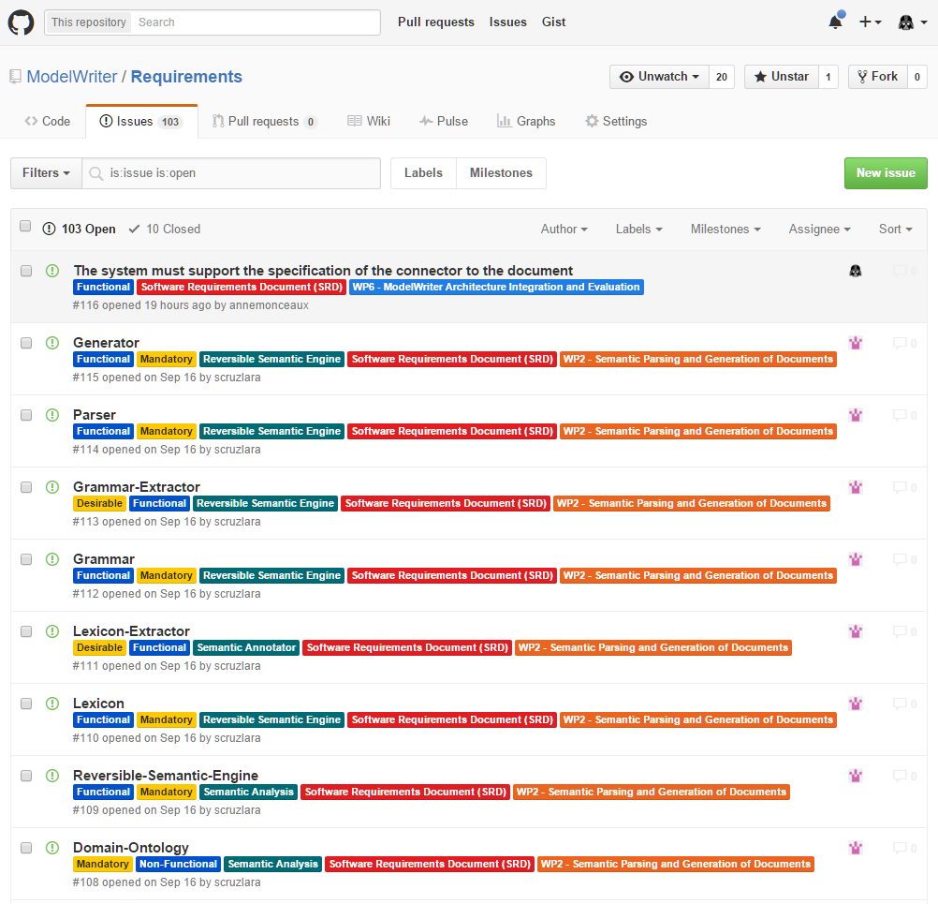
Requirement Management – GitHub https://github.com/ModelWriter/Requirements/issues

Slide 90
Requirement Management – Waffle.io https://waffle.io/ModelWriter/Requirements

Slide 91
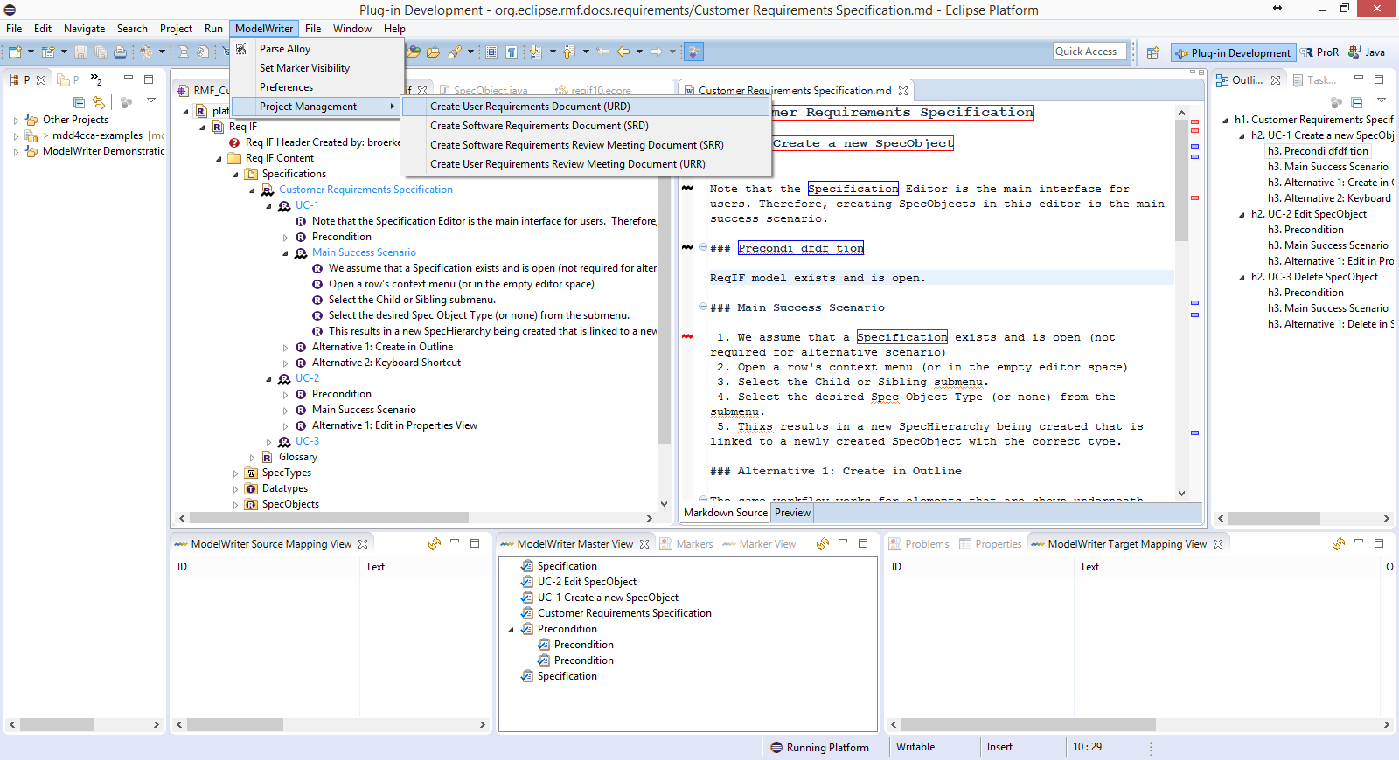
User Requirement Document (URD) & Software Requirement Document (SRD) I

Slide 92
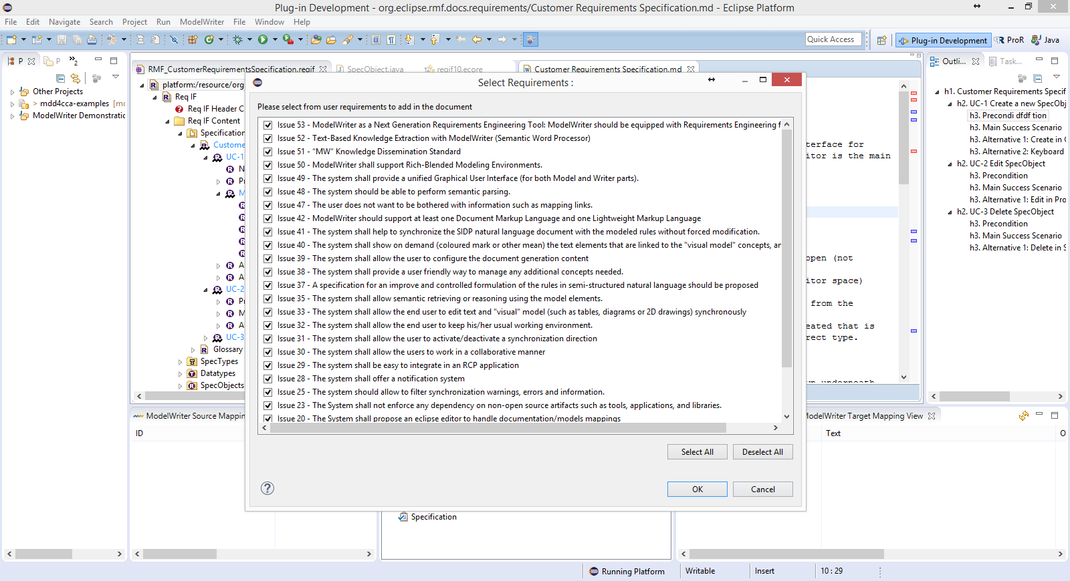
User Requirement Document (URD) & Software Requirement Document (SRD) II

Slide 93
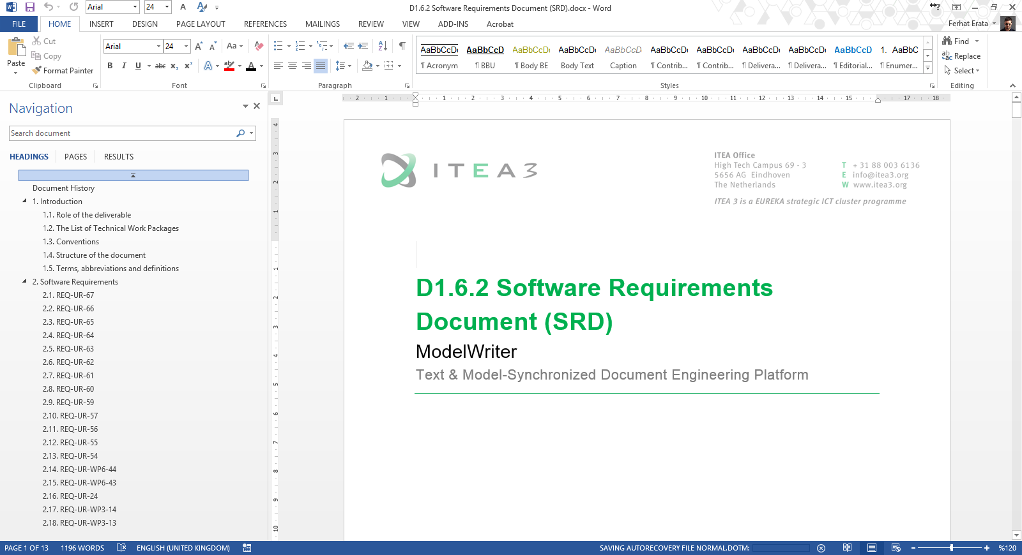
User Requirement Document (URD) & Software Requirement Document (SRD) III

Slide 94
T1.8 Technical Risk Assessment
OBEO, UNIT, KOCSISTEM + ALL
To identify, monitor and mitigate risks on the achievement of the project
Status
1st evaluation using Actuarial Approach of Technical Risk Assessment (TRA) of risks linked to requirements (URD, SDR) and technologies.
D1.8.1 Technical Risk Assessment v1.0
Next
The document may be up-dated throughout the project with special review at the same time as for the software requirements and the architectural design review, depending on the further details and requirements we get from the industrial use case providers.

Slide 95
WP2 - Semantic Parsing and Generation of Documents and Documents Components
Claire GARDENT, Mariem MAHFOUDH
CNRS / LORIA
Samuel CRUZ-LARA
University of Lorraine / LORIA

Slide 96


WP2 - Semantic Parsing and Generation of Documents and Documents Components
Goal: Provide tools and methods for:
Annotating text fragments with model elements
Converting texts to models and models to text
Tasks:
T2.1 Data Collection
T2.2 Semantic Parsing
T2.3 Natural Language Generation
T2.4 Definition of a common target semantic language
T2.5 Development of a Semantic Parser and of a Natural Language Generator

Slide 97

T2.1 Data Collection
AIRBUS (Confidential Data)
Text
System Installation Design Principles (SIDP) Documents
986 semi-structured SIDP rules
Models
The Rule ontology represents the SIDP rules concepts. An OWL ontology composed of 30 classes, 35 object properties and 54 data properties.
The Component ontology represents the concepts and the vocabulary used in system installation rules. It is an OWL-DL ontology and it is composed in its current version of 476 classes, 21 ObjectProperties and 35 DataProperties.
Non Disclosure Agreement finalised in June 2015.

Slide 98

T2.1 Data Collection
OBEO
Text
“TxStyle" Files: a set of files in natural language (i.e., English) related to the documentation of the application being modelled by Sirius
Models
Java Concepts: a list of Java identifiers (i.e., classes, interfaces, methods, etc.) related to Sirius
Ecore Concepts: a list of concepts related to Ecore (the Eclipse Modeling Framework meta model) and to Sirius

Slide 99
T2.2 Semantic Parsing
Developed a prototype illustrating the automatic construction of an RDFS KB from text (CNRS/LORIA)
« Parsing Text into RDF » B. Batouche, C. Gardent and A. Monceaux. SEPLN 2015, Alicante, Spain.
Full scale Implementation applied to AIRBUS SIDP rules (Airbus)

Slide 100
T2.3 Natural Language Generation
D2.2.1 Report: Overview and Comparison of Existing Generators
Keynote at SEPLN 2015, Alicante, Spain
2 Internships on generation from RDF data (ongoing)
Lexicalization: automatic acquisition of a lexicon mapping RDF properties to natural language expressions
Document planning: automatic detection of typical document structures using DBPedia and Wikipedia

Slide 101

Semantic Annotation: Creating and Maintaining Synchronization Links, Checking their Consistency

Slide 102
ModelWriter Text & Model-Synchronized Document Engineering Platform
Creating synchronization links (relating text and model) Checking the consistency of created synchronization links
Maintaining synchronization links (create, search, delete, modify)

Slide 103
Creating Synchronization Links
Automatically
Exact matching: identified using String matching
Ex: Attach (text element) IsSameAs http://airbus-group/opd-function#Attach (ontology concept)
Morphological matching: identified using lemmatization and Stanford CoreNLP tools
Ex: Attached IsMorphologicallySimilarTo http://airbus-group/opd-function#Attach
Semantic matching: identified based on ontology and SKOS labels
Ex: Fixation isSynonymTo http://airbus-group.installsys/component#AttachmentPoint
Manually
UserLink: Created by the user

Slide 104
Checking the Consistency of Synchronization Links
Consistency check based on ontology's axioms and properties
Rule:
If a text element and an ontology concept are semantically disjoint, then they cannot be synchronized
Ex: rigid Component cannot be synchronized with http://airbus-group.installsys/component#FlexibleComponent

Slide 105
Maintaining Synchronization Links
Link maintenance operations:
Add New Link (user given)
Search Link (create or retrieve)
Remove Link
Synchronisation between text and links
RenameTextElement
Add TextElement
RemoveTextElement

Slide 106
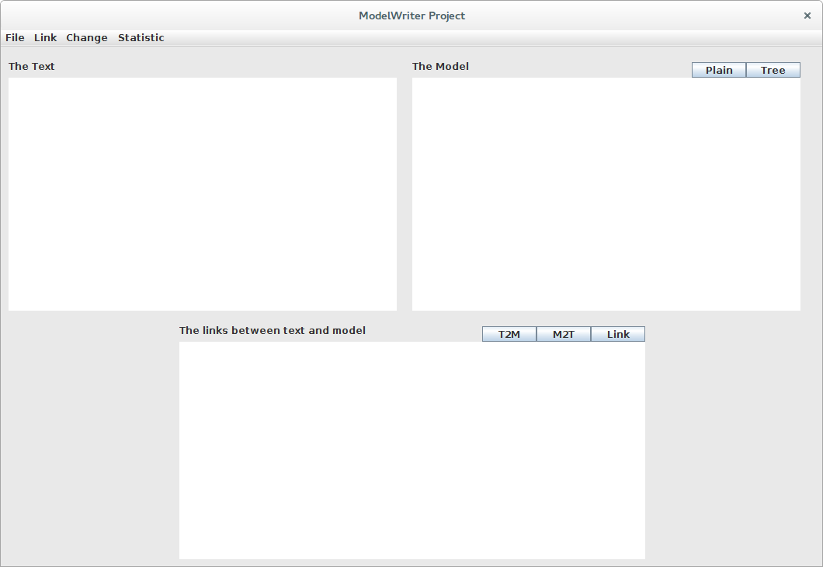
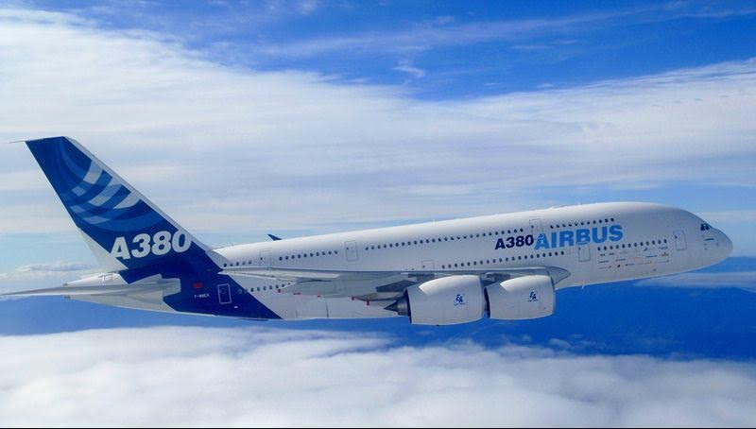
Semantic Annotation, Links Synchronization and Consistency Check
Application to Airbus Industrial Case

Slide 107
Semantic Annotation, Links Synchronization and Consistency Check
Semantic parsing and consistency check:
The prototype can be accessed on the GitHub Model Writer repository:
https://github.com/ModelWriter/WP2/tree/master/Tool

Slide 108

Semantic Annotation

Slide 109
Semantic Annotation
OBEO Corpora
EMF (Eclipse Modeling Framework)
The EMF project is a modeling framework and code generation facility for building tools and other applications based on a structured data model
From a model specification described in XMI, EMF provides tools and runtime support to produce a set of Java classes for the model, along with a set of adapter classes that enable viewing and command-based editing of the model, and a basic editor
SIRIUS
Is an Eclipse project based on EMF

Slide 110
Semantic Annotation
SIRIUS
A modeling workbench created with Sirius is composed of a set of Eclipse editors (diagrams, tables and trees) that allow the users to create, edit and visualize EMF models
The editors are defined by a model that defines the complete structure of the modeling workbench, its behavior and all the edition and navigation tools
For supporting specific need for customization, Sirius is extensible in many ways, notably by providing new kinds of representations, new query languages and by being able to call Java code to interact with Eclipse or any other system

Slide 111
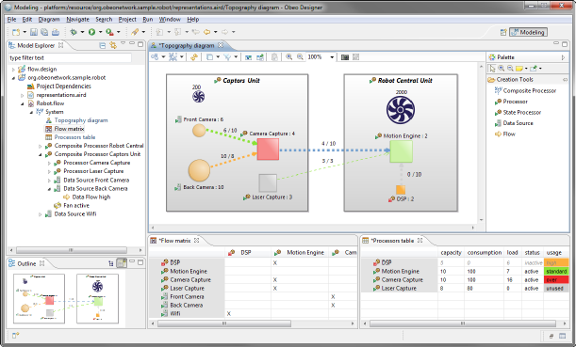
Semantic Annotation
SIRIUS

Slide 112
Semantic Annotation
OBEO Corpora
Java Concepts: a list of Java identifiers (i.e., classes, interfaces, methods, etc.) related to Sirius
Ecore Concepts: a list of concepts related to Ecore (the EMF meta model) and to Sirius
“TxStyle" Files: a set of files in natural language (i.e., English) related to the documentation of the application being modeled by Sirius

Slide 113

Semantic Annotation
A semantic annotator
We have developed is a basic prototype allowing to annotate the “TxStyle” files by establishing links to Java Concepts and to Ecore Concepts
Java Concepts
Model
Ecore Concepts
Annotated
TxStyle File
TxStyle File
Annotator
Document

Slide 114
Semantic Annotation
A semantic annotator
The prototype can be accessed on the GitHub Model Writer repository:
https://github.com/ModelWriter/WP6/tree/master/EcoreConcepts-JavaConcepts-Annotator

Slide 115
WP3 - Model to/from Knowledge Base Synchronization Mechanism
Moharram Challenger, R&D Director
UNIT Information Technologies R&D

Slide 116
WP3 - Model to/from Knowledge Base Synchronization Mechanism
Objective: provide the synchronization mechanism to keep the “user-visible models” consistent with the “KB-stored models”
This will consist of the following main plug-in components:
Transformation Manager: provides the infrastructure to register and launch transformations.
Configuration Manager: for personalizing the behaviour of the framework to meet the needs of a specific standard / organization / project / individual.
Traceability Manager: keeps links between elements of user-visible models and elements of the KB.
Synchronization Manager: triggering transformations when synchronization is needed.

Slide 117
Tasks
T3.1 - Review of M2M transformation approaches
T3.2 - Specification and design of the M2M Transformation Framework
T3.3 – Development of the Transformation Manager component
T3.4 – Development of the Configuration Manager component
T3.5 – Development of the Traceability Manager component
T3.6 – Development of the Synchronization Manager component
T3.7 – Design of the model-to-model transformations
T3.8 – Implementation of the model-to-model transformations
T3.9 – Validation of the M2M Transformation Framework

Slide 118
Configuration: Havelsan example
A Formal Specification Model to configure the ModelWriter

Slide 119

Traceability: Havelsan example
A Formal Specification Model to configure the ModelWriter

Slide 120
T3.1 - Review of M2M transformation approaches
UNIT, KOCSISTEM
A systematic review of model-to-model transformation approaches, and a selection of the most convenient and widely used in the industry for inclusion into the ModelWriter tool
Status
Survey of available approaches and tools are available at:
D3.1.1Review of model-to-model transformation approaches and technologies
Next:
The document may be updated based on the new approaches and tools in SotA

Slide 121
T3.2 - Specification and design of the M2M Transformation Framework
UNIT + KOCSISTEM
Objective: Designing the M2M Transformation Framework whose main goal is to make the ModelWriter tool able to launch M2M transformations
Status:
D3.2.1 - M2M Transformation Framework architectural design document (incl. Transformation, Configuration, Traceability, and Synchronization architectural design)
Next:
The architecture may be updated based on the new needs during the project progress.

Slide 122
T3.2 - Specification and design of the M2M Transformation Framework
Overview of the components of the M2M Transformation Framework:

Slide 123
T3.3, T3.4, T3.5, T3.6 (UNIT + KOCSISTEM)
Development of the:
T3.3 Transformation Manager component
T3.4 Configuration Manager component
T3.5 Traceability Manager component
T3.6 Synchronization Manager component
Status:
These tasks has software deliverables which are developed and are available at GitHub
Next:
These components will be updated.

Slide 124

T3.3, T3.4, T3.5, T3.6 (UNIT + KOCSISTEM)

Slide 125

T3.3, T3.4, T3.5, T3.6 (UNIT + KOCSISTEM)

Slide 126
T3.3, T3.4, T3.5, T3.6 (UNIT + KOCSISTEM)
The fully functional demonstration of the main components of WP3 (T3.3, T3.4, T3.5, T3.6) will be presented at demonstration session.

Slide 127
WP4 – Knowledge base Design and Implementation
Prof. Dr. Erhan Mengusoglu
MANTIS

Slide 128
WP4 Knowledge Base Design and Implementation
Design and implement the ModelWriter’s federated Knowledge Base itself, hosting multiple formalisms.
Design and implement its bi-directional text-model synchronization mechanism.
Design and implement its API.
Design and implement a set of specialised modules (plug-ins) that exploit the Knowledge Base in ways that make the tasks of Technical Authors much more productive, e.g. consistency checks.
Design and implement the collaborative functions linking and hierarchically organizing multiple ModelWriter KBs used by different Technical Authors on different sites.

Slide 129
WP4 Knowledge Base Design and Implementation
Plug-in #1 – This provides consistency and completeness checks within the same software lifecycle document, allowing automatic quality review of the content (meaning).
Plug-in #2 – This provides consistency and completeness checks between related set of documents.
Plug-in #3 – This provides semantic comparison between two versions of the same software lifecycle document (i.e. what conceptual changes have happened).

Slide 130
WP4 Knowledge Base Design and Implementation
T4.1 - Design of the Knowledge Base (MANTIS + OBEO + KUL2 + UNIT + KOCSISTEM)
T4.2 - API of the Knowledge Base (KOCSISTEM + KUL2 + + OBEO + UNIT + HISBIM)
T4.3 - Implementation of the Knowledge Base (KUL2 + MANTIS + HISBIM)
T4.4 – Plug-in #1: ModelWriter-assisted requirements review (KUL2 + MANTIS)
T4.5 – Knowledge Base serialization and reuse plug-in (MANTIS)
T4.6 – Plug-in #3: ModelWriter-assisted semantic comparison of 2 documents (OBEO + MANTIS + HISBIM)
T4.7 – Plug-in #2: ModelWriter-assisted compliance review (MANTIS + UNIT + AIRBUS +SOGETI)
T4.8 – Internal bi-directional synchronization mechanism (OBEO + UNIT)
T4.9 – External synchronization mechanism for collaborating ModelWriters (HISBIM)

Slide 131


WP4 - T4.1 – Design of the Knowledge Base
Semantic Web
RDF Expression

Slide 132

Ontology as a service

Slide 133
Implemented Services
executeQuery (ontology, queryString): Executes queryString (a SPARQL query) against ontology and returns triples.
exportFromOntology (ontology, outputFile, type): Exports the content of ontology into outFile of type type. Type is either CSV or RDF.
importIntoOntology (ontology, inputFile, type): Imports the content of inputFile of type type into ontology. Type is either CSV or RDF.
insertTriple (ontology, triple): Inserts triple into ontology.
removeTriple (ontology, triple): Deletes triple from ontology.
updateTriple (ontology, tripleOld, tripleNew): Changes the value of tripleOld as tripleNew in ontology.

Slide 134
WP5 – Project Management (UNIT)
Moharram Challenger, R&D Director
UNIT Information Technologies Ltd.

Slide 135
WP5 - Overview
Objectives:
To perform overall project governance, and to establish and maintain a communication and controlling infrastructure to run the project smoothly.
Status:
Project Coordination Committee (PCC) and Technical Coordination Committee (TCC) are constituted.
Collaboration mechanism is stablished
Development management environment is created
Next:
The 1st release will be issued

Slide 136
WP5 - Tasks
T5.1 – Communication Management and Collaboration Infrastructure (UNIT + WP7 leader)
T5.2 – Project Coordination and Reporting (UNIT + Country Coordinators + WP Leaders)
T5.3 – Project Controls (UNIT + WP Leaders)
T5.4 – Closing Project (UNIT + WP Leaders)

Slide 137
T5.1 Communication Management and Infrastructure
Mailing lists
Source Code Management
Document management
Scrum Management
Issue Management and Bug Tracking:
GitHub.com/ modelwriter
Google Docs and GitHub
Waffle and GitHub
GitHub
Project Communication
Social Media
Twitter
Linkedin
Website
@modelwriter.eu

Slide 138

Deliverable Management – GitHub https://github.com/ModelWriter/Deliverables/issues

Slide 139

Deliverable Management – Waffle.io https://waffle.io/modelwriter/deliverables

Slide 140



Source Code Management – GitHub, EGit https://github.com/ModelWriter

Slide 141
T5.2 Project Coordination and Reporting
Yearly ITEA review meetings
National review meetings (e.g. in every 6 month in Turkey)
International workshops: face to face meetings (in each 3 months)
Monthly International Telco meetings
Weekly collaboration meeting: e.g. UNIT-KS
Action specific meetings: e.g. Airbus-UNIT action, UNIT-Havelsan …

Slide 142
T5.3 – Project Controls
Monitoring the deliverables
Monitoring the requirements
Decision mechanism for addressing issues, changes, risks
Progress controls by means of
monitoring,
regular meetings and
reports such as
Kick-off and closing report
Project management plan
Yearly ITEA PPR
National progress reports

Slide 143
WP6 – Architecture, Integration and Evaluation (OBEO)
Yvan lussaud
OBEO

Slide 144

WP6 ModelWriter Functional Architecture

Slide 145
WP6 Integration
Source code
Github repository
Checkstyle and code templates
Target platforms
Continuous integration
Next steps
Jenkins
Provide an update site and an Eclipse product
integrate existing components
Ease the release process

Slide 146
WP6 Evaluation
Unit testing
JUnit
Code coverage (Eclemma)
Integration testing
Use cases
Jenkins will run all tests on a daily basis
Functional testing via GUI (RCPTT)
Milestone functional testing
Drives features and enhancements

Slide 147
WP7 – Standardization, Dissemination and Exploitation (OBEO)
Yvan lussaud
OBEO

Slide 148
WP7 Standardization
Specification and verification of ALM platform
Change impact analysis and visualization
System installation component ontology
Semantic annotator
Synchronization engine prototype
Open source software - traceability
Open source software – relational calculus
De facto standard – Airbus vocabulary
Open source software – API for text annotation
Open source software – Eclipse Intent contribution

Slide 149
WP7 Dissemination
International ModelWriter workshops
Parsing text into RDF
5th Turkish Software Architecture conference
6 workshops – 2 open workshops
Keynote on text generation at SEPLN 2015
Keynote speech at International Workshop on Advanced Topic in Software engineering
Publication poster – propose a RDF-based method for querying the content of a text
Develop an open source community for model and text synchronization
Spanish Natural Language Processing Conference – academics and industrials – a project session
Present Eclipse ecosystem and Modeling approach to software engineering

Slide 150
WP7 Exploitation
Requirement documents and ReqIF standard synchronization
CSV to OWL transformation
SIDP installation rule model
Collaboration between UNIT and HAVELSAN
Traceability in ALM platform – applied to Microsoft Team Foundation Server – support of KoçSistem
Prototype – automatic synchronization between ReqIf models and requirement documentation
Generates a triple dataset to populate the SIDP (System Installation Design Principle) rule model
Model of SIDP installation rules using RDFS and OWL languages

Slide 151
WP7 Exploitation
Enhancement in text connector for Airbus
Collaboration/Participation of FORD-Otosan
Collaboration between Obeo and Airbus
Expertise on document extraction
Syntactical parsing of SIDP rules based on templates
Long term support – semantic parsing and traceability for Product Life Cycle documents
Discussions on topics related to the ModelWriter scope
Improve expertise on information extraction for reverse engineering purpose

Slide 152
Thank you for your attention We value your opinion and questions.

Slide 153
4 Progress on the Industrial Use Cases
Prof. Geylani Kardaş, Moderator
KoçSistem

Slide 154
UC-FR-01 - Synchronization between models and documents
Yvan lussaud
OBEO

Slide 155
UC-FR-01 Development of Sirius
Graphical Mapping DSL
Source code
Documentation (specifier, user)
Life cycle
Artifacts
Release train Eclipse
Dependencies
Team
Core team
External contributors
Methodology
Code review
Plan manual synchronization of artifacts

Slide 156
UC-FR-01 Problematic
Synchronization gap
Validation
Development
Release
Artifacts knowledge is volatile
Quality

Slide 157
UC-FR-01 Concern
Internal validation of ModelWriter approach
Contribute to Intent
Mapping tooling
Live validation feedback
Batch validation
Fixing assistance

Slide 158
UC-FR-02 - Enterprise Architecture
Yvan lussaud
OBEO

Slide 159
UC-FR-02 Enterprise Architecture
Define As-Is state
Import documents
Define To-Be state
Modify the company model
Consolidate the company model
Define trajectories
Gap analysis
Impact analysis
Define milestones
Identify possible scenario
Evaluate possible scenario

Slide 160
UC-FR-02 Problematic
Validation
Organizational changes
Produce documentation of organizational changes
Artifacts knowledge is volatile
Quality
Synchronization gap
Documentation
Keep track of sourced documents
Keep representation and portal up-to-date

Slide 161
UC-FR-02 Concern
Industrial use of ModelWriter tooling
Contribute to Intent
Mapping tooling
Live validation feedback
Batch validation
Fixing assistance

Slide 162
UC-FR-03 - Synchronization of Regulation Documentation with a Design Rule Repository
Anne MONCEAUX
Airbus Group Innovation
Louis ROUCH, Ayhan MOHOVIC
Airbus SAS

Slide 163



SIDP: “System Installation Design Principles”
Notes:
SIDP is used (under Non Disclosure agreement) as a use case

Slide 164
Context and problem
SIDP documents explain how to install the aircraft systems and attach them to the structure. They capitalize the best practices & proven technical solutions.
SIDP are defined per ATA chapter (~functional domain) to be applied for each given A/C project: for example “A350 Electrical installation”
SIPD are open to Extended Enterprise: installation tasks are performed by risk sharing partners.
SIDP are living documents: during the aircraft development any new DP allowing to satisfy all targets/constraints can be added, assuming it is validated by Airbus dedicated committee.

Slide 165
Industrial high level needs
To improve SIDP creation, maintenance and consultation in order to:
save costs by supporting DP consultation / retrieval in accordance to the needs
avoid non-compliance of design caused by DP updating lead times
keep traceability with upstream regulations and requirements and downstream design models

Slide 166
Synchronization of regulation documentation with a design rule repository

Slide 167
UC-FR-03 Synchronization of regulation documentation with a design rule repository
Goal: synchronizing the SIDP database content with documentation
Create links between text fragments & model elements (manual annotation?, semi-automatic?…)
Manage consistent synchronization (manage changes)

Slide 168
UC-FR-03 Synchronization of regulation documentation with a design rule repository
Approach: limited case on Electrical Installation functional domain
(Confidential Data - Non Disclosure Agreement finalized in June 2015).
Text
1 document: SIDP ATA 92
In our industrial context SIDP are edited using MSWord
Models
An OWL model is built that reflects the DB schema: “Rule ontology” (30 classes, 35 object properties and 54 data properties)
Automatic population mechanism of the model from a csv BD export produces the KB (45781 triples)
Notes:
Why an OWL model?
- Natural

Slide 169

UC-FR-03 Synchronization of regulation documentation with a design rule repository
Status 1st iteration: synchronizing the SIDP KB content and text part
Thermal variation shall be taken into account
Structural deformation shall be taken into account
Pressurization Variation shall be taken into account
Component/Item/Object shall be qualified to withstand temperature reached by the routes they are in contact with
Model part = rule KB
Textual part = rule sentences

Slide 170
UC-FR-04 - Production of a Context Specific Design Document
Anne MONCEAUX
Airbus Group Innovation
Louis ROUCH, Ayhan MOHOVIC
Airbus SAS

Slide 171
UC-FR-04 Production of a context specific design document
Goal: producing document according to usage “needs”
Produce “filtered” document with subset of Design Principle textual elements according to usage “needs”

Slide 172
UC-FR-04 Production of a context specific design document
Approach:
use case Electrical Installation functional domain
Confidential Data - Non Disclosure Agreement finalized in June 2015
Use model elements to retrieve relevant Design Principles
Text
1 document: SIDP ATA 92
In our industrial context SIDP are edited using MSWord
Models
The previous Rule KB (populated Rule ontology)
Component ontology (476 classes, 21 ObjectProperties and 35 DataProperties)
Notes:
Why an OWL model?
- Natural

Slide 173
Component classes taxonomy
ObjectProperties
Component
Assembly
“Structural_Element”
subClassOf
“Bracket”
Physical component
Attachment device
“Fastener”
“Pclamp”
Clamp
AnnotationProperties
Rdfs:label
“Assembly”
Skos:prefLabel
P-Clamp
P-Clamp NSA5516

Slide 174

Component classes taxonomy
“P-clamp NSA5516 can be fixed on X with Y”
“Physical component”
“Standard reference”
NLP Parsing uses this taxonomy. Labels + assumptions such as a physical component may be referred to using its name or its reference or both concatenated
Inference rule: a rule applying to a component type (Attachment device) applies to its subtypes (P-clamp)
Document display : when searching rules applying to a component type (P-Camp) → retrieve and display rules applying to super-types

Slide 175

SPARQL queries
Status : model based queries specification
Preliminary study with Loria (Text to RDF)
1 internship on RDFizer and Query management

Slide 176
UC-TR-01 - Documents of Quality Assurance Department
Ersan GÜRDOĞAN
HISBIM

Slide 177
T1.4 – Industrial Use Cases for Turkish Consortium
UC-TR-01 | Documents of Quality Assurance Department
Version | V1.0.0 dated 15-Nov-2014
Description | To create faster and more accurate the forms that are used in quality control progress and trigger related forms (re-work form triggering, revision needed, approved, rejected etc.)
Actors | Quality Managers, Quality Measurement Specialists, Quality Control Personnel, Quality Auditors, Production Crews
Assumptions | Quality control measurement units are standart Rejected and Approved products forms are standart Quality Certification standarts are always applied
Steps | Products information forms are created according to product information comes from ModelWriter system Products are measured by quality control department authorised personnels according to standarts To decide product is standart or not according to measurement report Product would be sent rejected products section if its measures are out of standarts ModelWriter system is created Rejected Product Quality Form Else Approved Product Quality Form is created by ModelWriter System Approved products are sent to warehouse as accepted products
Alternatives | If rejected products' measurement out of range in rework standarts, it means cannot be applied rework on this product, it returns to scrap. Then it should be sent wasteland.
Issues | Standartising form designs is hard because of all customers have their own unique reporting tools/formats

Slide 178

TR-UC-01 Documents of Quality Assurance Department

Slide 179
TR-UC-01 Documents of Quality Assurance Department
What we expect ModelWriter about QDMS:
Quality documents and forms are mostly too generic and similar. However some customers and users would like to customized documents. We would like to develop ModelWriter system could automatically generated QDMS related docs and forms with respect to Quality Test results.
With sharing utility QDMS documents will be send to company managers, quality department authorised personnel, related customers’ responsibles and suppliers2 responsibles if manufactured part comes from subcontractor.
What we have done until today about QDMS use case:
Customer segmentation done, customer database and data relations are ready for ModelWriter
Suppliers information are acqisied from database, ready to integrate ModelWriter system
Models of Quality Documents and forms have been completed

Slide 180
UC-TR-02 - Non-Disclosure Agreements
Ersan GÜRDOĞAN
HISBIM

Slide 181
T1.4 – Industrial Use Cases for Turkish Consortium
UC-TR-02 | Non-Disclosure Agreements
Version | V1.0.0 dated 15-Nov-2014
Description | Non-Disclosure Agreement (NDA), also known as a confidentiality agreement (CA), confidential disclosure agreement (CDA), proprietary information agreement (PIA), or secrecy agreement (SA), is a legal contract between at least two parties that outlines confidential material, knowledge, or information that the parties wish to share with one another for certain purposes, but wish to restrict access to or by third parties. It is a contract through which the parties agree not to disclose information covered by the agreement. An NDA creates a confidential relationship between the parties to protect any type of confidential and proprietary information or trade secrets. As such, an NDA protects nonpublic business information. NDAs are commonly signed when two companies, individuals, or other entities (such as partnerships, societies, etc.) are considering doing business and need to understand the processes used in each other's business for the purpose of evaluating the potential business relationship. NDAs can be "mutual", meaning both parties are restricted in their use of the materials provided, or they can restrict the use of material by a single party. It is also possible for an employee to sign an NDA or NDA-like agreement with an employer. In fact, some employment agreements will include a clause restricting employees' use and dissemination of company-owned confidential information.
Actors | Responsible/Authorised personnel in both parties.
Assumptions | Agreements are prepared and written according to European Business Law.
Steps | To define both partied who would sig the NDA To write items of agreement according to scope of NDA Reviewing agreement by decision maker then getting approval Sharing NDA each other Send feedback to ModelWriter system if any change apply on NDA Sahepen final version of NDA then signing by both parties
Alternatives | After sharing NDA, both parties sign without any change and no feedback imzalanması. Cancellation of NDA
Issues | Different laws could be applied in out of European Union

Slide 182

TR-UC-02 Non-Disclosure Agreements
Company Information of Parties who sign NDA
Items of NDA with respect to contracted project(s) between parties, project related information such date of document, content of project etc.
Responsible names and their signatures from each party

Slide 183
TR-UC-02 Non-Disclosure Agreements
What we expect ModelWriter about NDAs:
Automatically captured parties information, main company and customer information
Automatically filled names and signatures (if digital/electronical signatures)
Automaticaly generate items according to given project ID
With sharing utility ModelWriter will be able to send finalised and revised NDA to related parties and their contracted lawyers to review.
What we have done until today about NDA use case:
Company information acquisition from database is done
Customer segmentations completed ready to integrate and acquisite their data to ModelWriter
Projects database relations have been built, ready to integrate ModelWriter engine

Slide 184

ModelWriter Plug-in for Microsoft Word
2
3
1
1) Written text in main window of Ms-Word
2) Ribbon in upper menu tabs
3) Action Pane on left-hand side

Slide 185
UC-TR-03 - Synchronization of ReqIF models from requirement specifications
Ferhat Erata
UNIT- KoçSistem

Slide 186
UC-TR-03 - Synchronization of ReqIF models from requirement specifications
Technical documents are usually long and have complex structure
For example requirement or specification documents
These documents keep changing in the time frame and need to be consistent with the other artifacts
For example, with a ReqIF model
In this use case we aim to keep these documents and models synchronized
This will include bidirectional transformation of documents and models
Notes:
ReqIF is widely used standard to interchange requirements between partners, esp. İn automative industry.

Slide 187
UC-TR-03 - Synchronization of ReqIF models from requirement specifications
Specification
Document
Technical Document
Doc Model
Synchronization
Transformation
ReqIF Models
Synchronization Transformation
Requirement Document
At the current progress status of this UC:
The transformation is done in one way (left to right)
The synchronization is done only between DocModel and ReqIF models

Slide 188
UC-TR-03 - Synchronization of ReqIF models from requirement specifications
Sample Applications:
Airbus SIDP templates ⬄ ReqIF
Havelsan Requirement doc templates ⬄ ReqIF
University Management System docs ⬄ ReqIF
Eclipse RMF specifications ⬄ ReqIF
The initial implemented version of this use case will be presented in the demonstration session.

Slide 189

UC-TR-03 Screenshots - Airbus SIDP templates

Slide 190

UC-TR-03 Screenshots - Havelsan Requirement docs

Slide 191

UC-TR-03 University Management System docs

Slide 192

UC-TR-03 Screenshot - Eclipse RMF specifications

Slide 193
Next Steps
Next steps:
ReqIF model transformation to documents (bi-directional transformation)
Synchronization between a document and Doc-Model (fully synchronization)

Slide 194

Model Writer
Work Package 1 - Industrial Use Cases and Requirements
Integration with Application Lifecycle Management tools
Eray TÜZÜN (HAVELSAN )
Yagup MACİT (HAVELSAN)
UNIT - KoçSistem

Slide 195






Requirement Work Item
Customized Form
Attributes
WorkItem Number Patterns
History
Discussion

Slide 196

Requirement LifeCycle
Notes:
We defined a structured requirement object as an entity, that have a set of lifecycle states, defined transitions between these states, history of changes, related attributes (unique id, priority, severity, validation method etc.), and traceability information to various project artefacts such as other requirements, design model, source code, bugs, test cases etc.

Slide 197
Requirements Traceability

Slide 198
Requirements in ALM

Slide 199
Requirements in ALM
Traceability with other artifacts is key
Requirements to other requirements
Customer/System/Software/Hardware..
Dependency relation between requirements
Requirements to tasks (Project management)
Requirements to Test Cases
Requirements to Design elements
Requirements to generated documents
Requirements to source code
Requirements to Build
Requirements to bugs
Requirements to risks
…
Notes:
Requirements Engineering is not a separate activity. It is part of ALM. Requirements as a document or a separate entity does not mean anything.
A lot of the big software development companies have made a lot of investments to build an integrated ALM platform which would cover the entire lifecycle of an application.
This Use Case aims at integrating ModelWriter with requirements management portion of the Application Lifecycle Management (ALM) tools. In a typical ALM platform, “requirement” is represented as a structured requirement object rather than text.

Slide 200
HAVELSAN Use case for ModelWriter
Currently we support scenario #1 and #4, and interested in Scenario #3, #2

Slide 201




Havelsan Ext - Document Generation
Preview
Word Extension
Support for Templates

Slide 202




Requirements - Design Model Traceability
Requirements would be imported to the Design tool for traceability.
Code generation from design

Slide 203
UC-TR-05 - Synchronous Business Process Design with Use Cases
Geylani Kardaş
KoçSistem, UNIT

Slide 204
UC-TR-05 - Synchronous Business Process Design with Use Cases
Use cases are one of the main approaches to represent the requirements.
A use case is a list of actions or event steps, typically defining the interactions between a role (a.k.a actor in the UML).
BPMN provides a graphical notation for specifying the processes in a diagram based on a flowcharting technique (similar to activity diagrams in UML).
The aim is to support business process management, for both technical and business users, by providing a notation which enables to represent complex process semantics.
However, the transformation and synchronization of use cases and BPMN models are challenges addressed in this UC.

Slide 205
UC-TR-05 - Synchronous Business Process Design with Use Cases
Use case Documents
Synchronization
Transformation
BPMN Models
Applications:
- University Management System Use cases docs ⬄ BPMN
- Eclipse RMF use case specifications ⬄ BPMN
At the current state of progress this UC:
The transformations are done in one way (left to right)

Slide 206

UC-TR-05 University Management System Use cases

Slide 207

UC-TR-05 Eclipse RMF use case specifications

Slide 208
UC-TR-05 - Synchronous Business Process Design with Use Cases
Demonstration:
The initial implemented version of this use case will be presented in the demonstration session.
Next steps:
BPMN model transformation to Use case documents (bi-directional transformation)
Synchronization between documents and BPMN Models
Using technique documents of Ford-Otosan;

Slide 209
Thank you for your attention We value your opinion and questions.

Slide 210
5 Demonstrations
Ferhat Erata (UNIT, ModelWriter Project Leader)
Dr. Mariem Mahfoudh (CNRS/LORIA)

Slide 211
6 Summary of the Current Status
Ferhat Erata
UNIT, ModelWriter Project Leader

Slide 212
Several Achievements
Exploitation of ModelWriter in ITEA3-ASSUME
New system (Exploitation)
Specification & Verification of ALM Platform
Open Source Software (Standardisation)
Change Impact Analysis & Visualization
Open Source Software (Standardisation)
System Installation Component Ontology
De facto standard (Standardisation)
Semantic Annotator
Open Source Software (Standardisation)
CSV to OWL transformation program
New product (Exploitation)
SIDP Installation Rule Model
New product (Exploitation)

Slide 213
Summary of the first year
We have a clear project structure and objectives.
We positioned new industrial partners.
We managed to restore the consortium with early changes in the leaderships
We have still the same ambition.
We have end users, clear needs; have enough tool & technology providers
We have already significant Exploitation Related Achivements
We have developed core ModelWriter
Knowledge Capture & Knowledge extraction
All software components are platform independent and open source

Slide 214
Thank you for your attention We value your opinion and questions.

